Slide 1

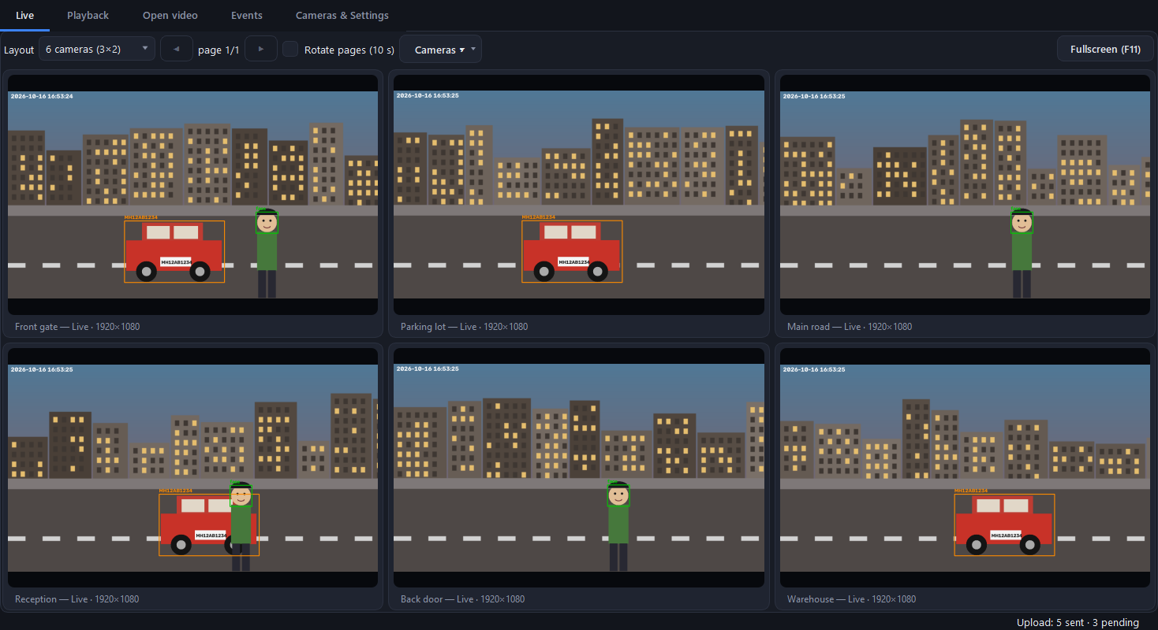
VIDEO INFORMATION EXTRACTOR
Every camera.
Every face.
Every number plate.
Sample scenes, drawn for illustration
A Windows app that watches your IP cameras, webcams and video files, and keeps a searchable record of who and what passed by.
Notes:
Open with the one-line promise: cameras that tell you who and what passed by. The screenshot shows sample scenes drawn for illustration.

Slide 2




The problem: cameras record, but tell you nothing
Hours of footage, no answers
Finding one visitor or vehicle means scrubbing through recordings by hand.
24 / 7
Plate numbers noted by hand
Slow, easy to get wrong, and easy to miss when it is busy.
cameras recording, nobody watching
Every camera, a different viewer
IP cameras, recorders (NVRs) and webcams each come with their own software.
What you need is a log of events you can search, not more video to watch.
Cloud services need the internet
Cloud analytics stop when the connection does, and your video leaves the building.
Video Information Extractor
2
Notes:
Describe the pain: someone has to watch. Finding a visitor or a vehicle means scrubbing footage. Plate numbers are written by hand.

Slide 3




The solution: from camera to searchable record
1. Connect
2. Detect
3. Capture
4. Store
5. Sync
RTSP cameras, NVRs, webcams or video files
Faces, vehicles and number plates, on your own PC
Photo, crop, plate text and the exact time
Saved locally, searchable by camera, time and plate
Sent to your server whenever it is reachable
Works offline. Nothing is lost when the network or the server is down: events wait in a queue and upload when the server is back.
Video Information Extractor
3
Notes:
Walk left to right. Emphasise that it works offline and syncs later.

Slide 4





Why it is different
Any camera, one app
Finds cameras for you
Private by design
RTSP cameras, NVR playback, USB webcams and saved video files in a single window.
Scans your network and tries the common stream addresses until one works.
Detection runs on your PC. Video never has to leave your building.
Never loses an event
Playback for any camera
Tuned per camera
Store first, upload later. Failed uploads retry until the server answers.
No NVR? Record locally and replay any time range later.
Turn faces, vehicles and plates on or off, and pick the video quality.
Video Information Extractor
4
Notes:
Pick two or three of these depending on the audience. Privacy and never-lose-an-event usually land best.

Slide 5
The logic: one pipeline per camera
1
Capture
One thread per camera. RTSP over TCP, automatic reconnect.
Rules that keep it accurate
2
Sample
A frame is analysed every 0.3 s; slow passes are skipped, never queued.
Face gone for 4 s = the next face is a new person
Same vehicle is not logged again for 30 s
Plates are 5 to 12 letters or digits, with at least one digit
A late plate read updates the same event
3
Validate
Faces need a real face layout and a person; vehicles a confident match.
4
Track
Each person or vehicle is followed, so it is logged once, not every frame.
5
Read plate
Plate text is read from the vehicle crop, retried up to three times.
6
Save, queue
Photo, crop and database row are written, then queued for upload.
Video Information Extractor
5
Notes:
Each camera runs in its own thread. The detector is shared so memory stays small.

Slide 6


Three detectors, each with a safety check
Faces
Vehicles
Number plates
YuNet detector
YOLOv8n (ONNX)
RapidOCR
• Eyes above nose above mouth, or it is rejected
• Must sit on a detected person, or score 0.9 or more
• Filters out pets, shadows and objects
• Cars, motorcycles, buses and trucks
• Also finds people, to verify faces
• Seen in 2 passes in a row before it is logged
• Reads inside the vehicle crop, enlarged
• Keeps only plate-shaped text
• Optional whole-picture reading for webcams
Runs on the CPU. All models run through onnxruntime, so no graphics card is needed.
Video Information Extractor
6
Notes:
Models run through onnxruntime on the CPU, so no graphics card is required.

Slide 7
Store first, upload later
Upload status of each event
Every detection becomes an event
Waiting for the server
Photo + crop
Full frame with the box drawn, and a close-up of the face or vehicle
Pending
Server answered with success
Two timestamps
The time in the video, and the time this PC detected it
Sent
Kept on this PC on purpose
Plate text
Added as soon as it is read, even a moment later
Local only
Local database
SQLite on the PC, searchable by camera, time and plate
The uploader checks the server every 15 seconds and retries until it gets a success reply.
Video Information Extractor
7
Notes:
Explain the three upload states. The server just needs to answer with a 2xx status.

Slide 8


A folder you can simply open
Photo file names
Detections
20261016-165318_20261016-165324_Front_gate_vehicle.jpg
video time · system time · camera
20261016_165324_4821
faces
vehicles
numbers.csv columns
full_frames
Number detected
numbers.csv
Camera or video name
Video reference date time
System date time
Choose the folder in Settings. It opens in Excel.
Video Information Extractor
8
Notes:
This is the human-friendly output: photos named by time and camera, and a CSV list of numbers.

Slide 9
Technologies used
Application
Vision
Text reading
Python 3.12
PySide6 (Qt 6) interface
Windows tray and autostart
OpenCV
YuNet face detector
YOLOv8n via onnxruntime
RapidOCR
onnxruntime on the CPU
No GPU required
Data
Cameras
Build and release
SQLite database
requests (HTTP upload)
psutil (network discovery)
RTSP over TCP (FFmpeg)
ONVIF WS-Discovery
DirectShow webcams
PyInstaller
Inno Setup installer
GitHub Actions and Releases
Video Information Extractor
9
Notes:
Everything runs locally. No GPU needed.

Slide 10


Supported platforms and sources
What it can watch
Where results go
RTSP IP cameras
Any web server
that accepts an HTTP POST. A PHP example is included.
Windows 10 / 11
NVR playback
64-bit installer
Runs in the system tray
Starts with Windows (optional)
Closes cleanly on Quit
USB and laptop webcams
Not in this release
Saved video files
Android or iOS app
Hosted web dashboard
Its own recordings
Video Information Extractor
10
Notes:
Be explicit that today it is a Windows desktop app. No mobile app or hosted web dashboard yet.

Slide 11
Live view: 4, 8 or 16 cameras
• Pick 1, 4, 6, 8, 9 or 16 cameras per page
• Rotate pages automatically
• Double-click a tile to focus it
• Fullscreen for one or many cameras
• Zoom and pan with the mouse
• Right-click a tile to switch face, vehicle or plate detection
Video Information Extractor
11
Notes:
Sample scenes are drawn for illustration. Every tile shows live detections with boxes and the plate text.

Slide 12
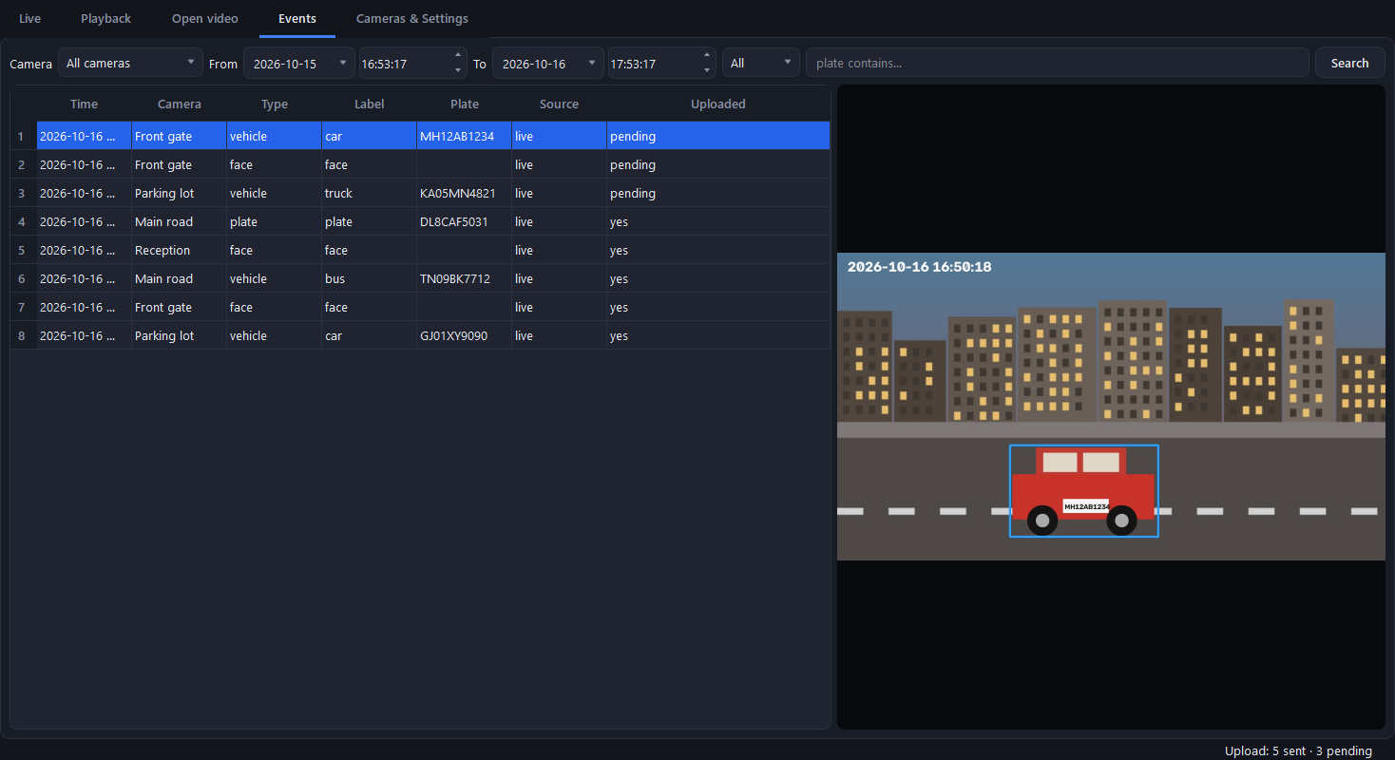
Events: every detection, searchable
• Filter by camera, date, time, type or plate text
• Click a row to see the photo
• Faces, vehicles and plates in one list
• Shows what has been sent to the server
• Works for live, playback and opened files
Video Information Extractor
12
Notes:
The Events tab is the searchable record. Plate search accepts part of a number.

Slide 13
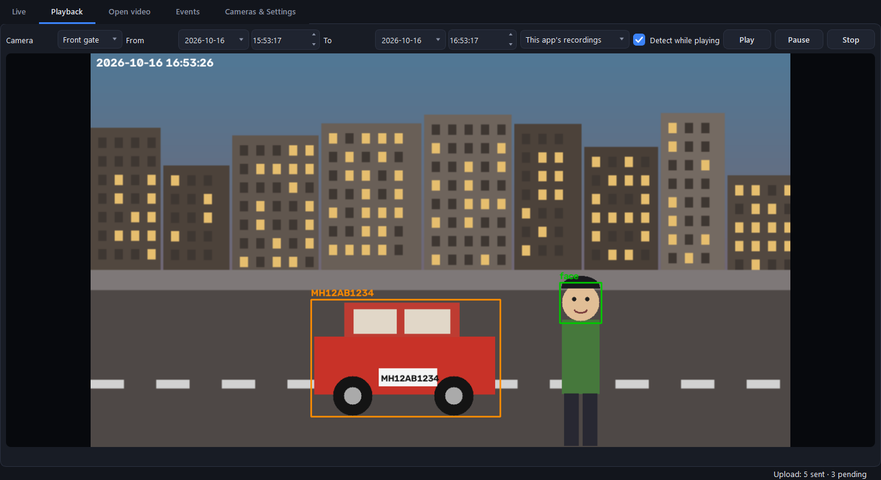
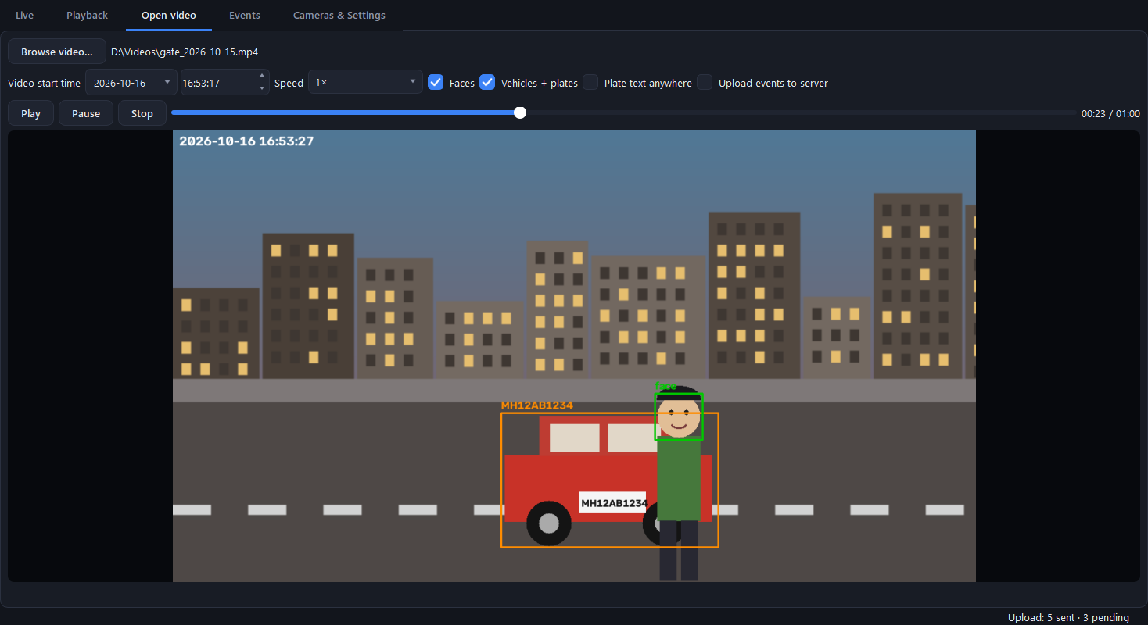
Playback and saved video files
Playback
Open video
• Choose a camera and a from and to date and time
• Camera or NVR playback, or the app's own recordings
• Detects while it plays
• Browse any saved video, seek and change speed
• Max speed analyses without skipping
• Set the real start time so events are dated correctly
Video Information Extractor
13
Notes:
Playback uses the camera or NVR when it supports it, or the app's own recordings. Open video analyses any file on the PC.

Slide 14
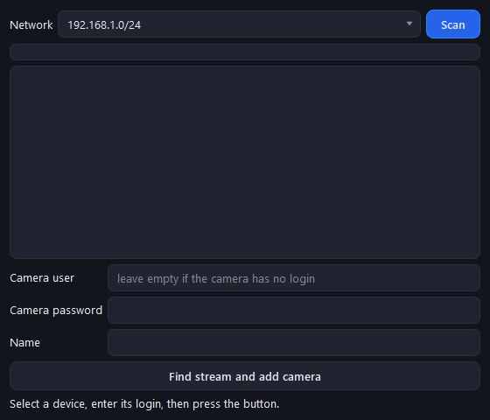
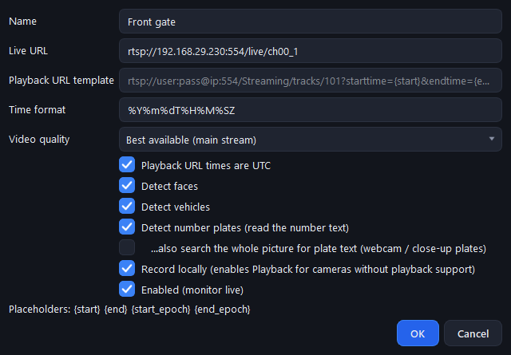
Adding cameras takes minutes
• Add a webcam in one click
• Best video quality chosen automatically
• Edit or turn off a camera any time
Scan network: finds cameras and the right stream address
Per camera: quality, faces, vehicles, plates, recording
Video Information Extractor
14
Notes:
The scan dialog finds devices with an RTSP port open, then tries known stream addresses.

Slide 15
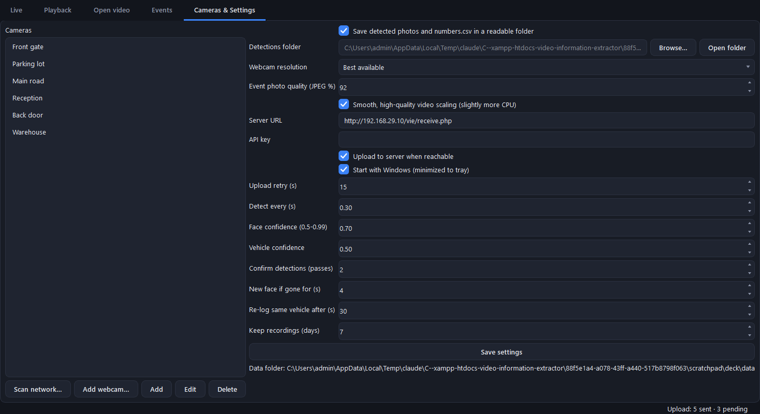
Settings you control
• Server address and optional API key
• Start with Windows
• Video quality and photo quality
• How sensitive face and vehicle detection is
• Where detection photos and numbers.csv are saved
Video Information Extractor
15
Notes:
Everything is saved on the PC and applied immediately.

Slide 16


The web side: your server, your data
Included sample receiver
What the app sends (HTTP POST)
id, camera_id, camera_name
ts, kind, label, plate, source
photo, crop (JPEG files)
X-API-Key header, if you set a key
Any 2xx reply marks the event as sent
receive.php stores each photo and crop in a folder per camera
Appends every event to events.jsonl
Checks the API key if you set one
Replace it with your own web app or database
Video Information Extractor
16
Notes:
There is no hosted dashboard. The app posts to any URL you set. The PHP sample stores photos and a JSON lines file.

Slide 17


Ideas for what comes next
Not built yet. Candidates for future versions.
Mobile viewer
Web dashboard
Person capture
Alerts
See live view and events from a phone.
Browse events from any browser.
Log people even when no face is visible.
Notify when a chosen plate or a person appears.
Video Information Extractor
17
Notes:
These are ideas, not shipped features. Ask the audience which one matters most.

Slide 18
Know who and what passed by.
Automatically.
Install from the GitHub Releases page: sumantakec-gif/video_info_extractor
Windows 10 / 11 · RTSP cameras, NVRs, webcams and video files · runs on your own PC
Notes:
Close on the promise and point to the installer on the GitHub Releases page.

