Slide 1


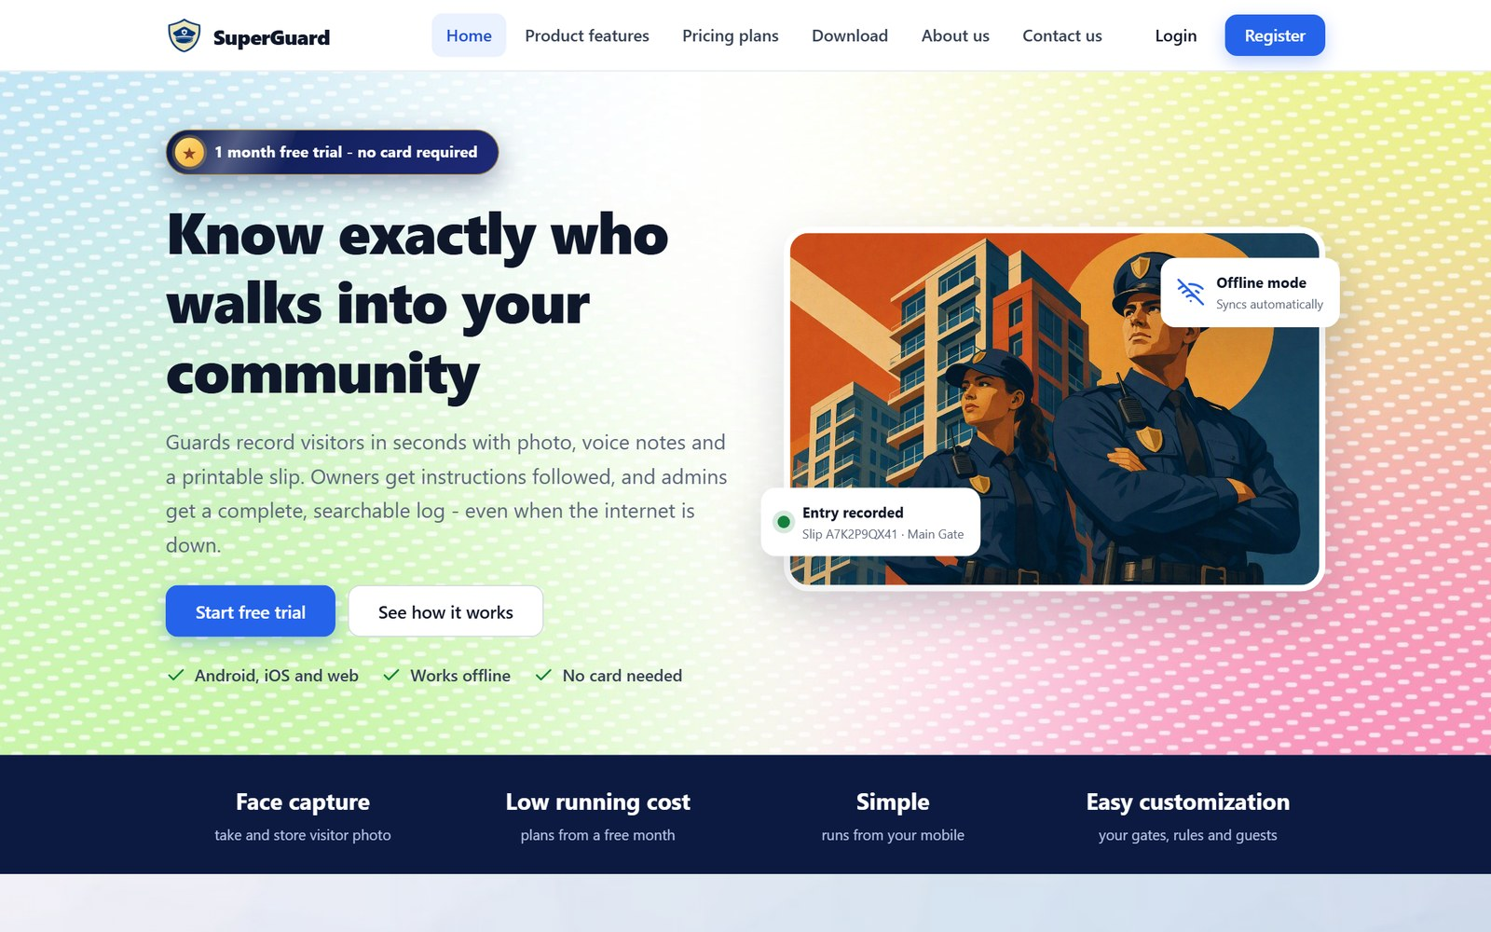
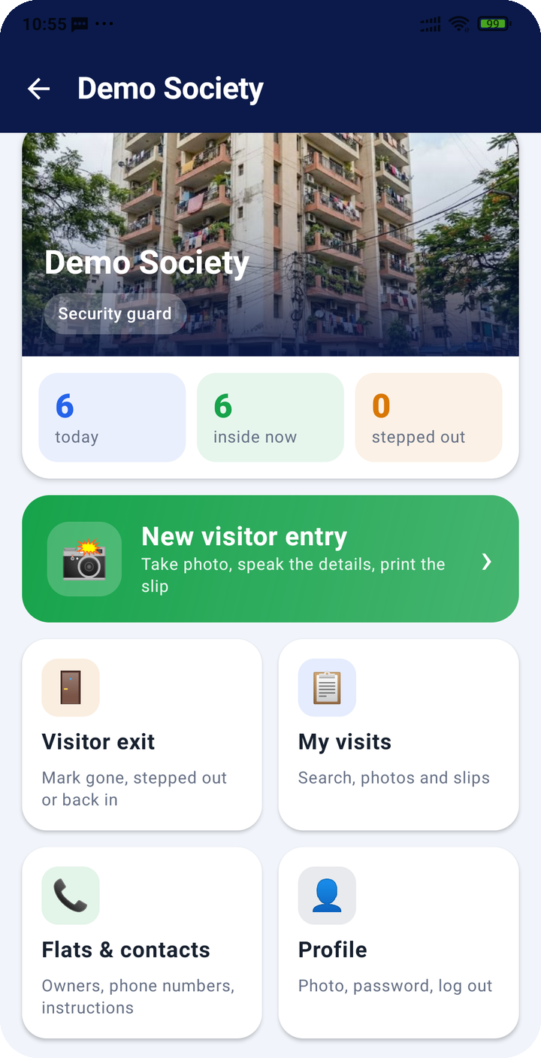
SuperGuard
Know exactly who walks into your community
Digital visitor management for gated communities: photo-verified gate entries, owner instructions and a searchable history on web, Android and iOS.
1-month free trial · no card
apsuma.com/superguard
Notes:
SuperGuard replaces the paper gate register with a phone app for guards and a web portal for residents and managers.

Slide 2
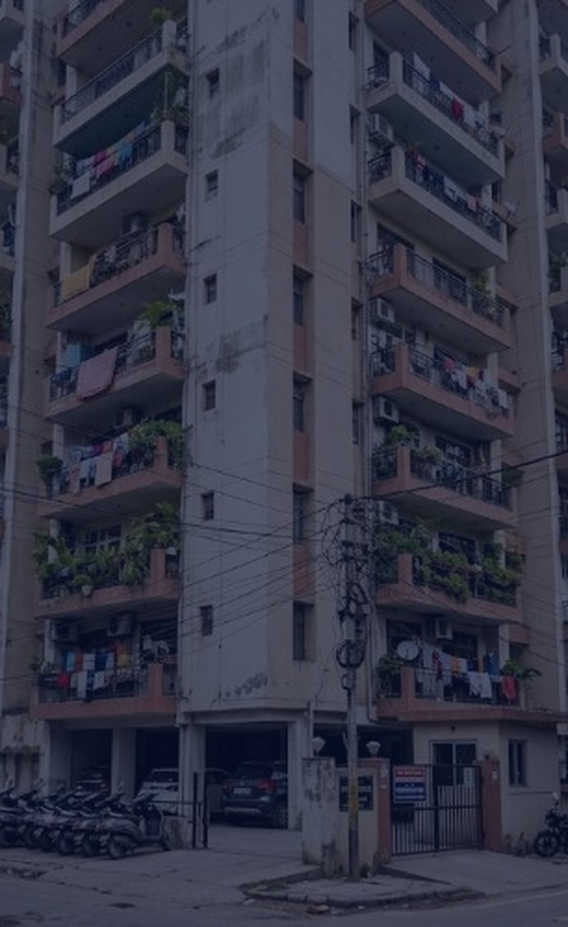




THE PROBLEM
The gate register can’t tell you who is inside right now
Paper logs prove nothing
Handwriting is unreadable, pages get lost, and there is no photo of who actually came in.
Owners are left out
Residents hear about visitors after the fact. “Call me first” gets forgotten at shift change.
Guards work blind
Most communities still log visitors by hand: one notebook per gate, filled in by a guard under pressure.
No list of flats, owners or phone numbers at the gate, so every check takes a walk or a guess.
No history, no oversight
Heads cannot search past visits, see who is still inside, or compare gates and guards.
SuperGuard · Visitor management for gated communities
2

Slide 3





THE SOLUTION
Every visit becomes a verified, searchable record
1
2
3
4
5
Photo
Flat
Details
Slip
Exit
Guard takes the visitor’s photo; the app checks a face is in it
Search by flat or owner; see the owner’s instructions and call
Name, phone, companions and purpose, typed or spoken
Entry saved with a slip code; print, PDF or email the slip
Mark gone, or temporary exit and re-entry
Guards
Owners
Community heads
Know whom to call, whom to let in and who is still inside.
See every visitor to their flat with photo, and set the rules.
Live numbers, full history and control of members and gates.
SuperGuard · Visitor management for gated communities
3

Slide 4






WHY SUPERGUARD IS DIFFERENT
Built for a real gate, not a front desk
Works offline
Face-checked photos
Speak instead of type
Entries are saved on the phone and upload by themselves when the network returns.
On-device face detection rejects a photo with no face, so every record shows a person.
Every field takes voice input; guards fill the form without a keyboard.
Owners set the rules
One login, many roles
No hardware, low cost
Call-before-entry, notes for guards and pre-approved guests with valid dates.
A guard in one community can own a flat in another, and switch inside the app.
Any Android phone at the gate. Plans from ₹150 a month after a free month.
SuperGuard · Visitor management for gated communities
4

Slide 5
LOGIC: ROLES AND ACCESS
Each person sees exactly what their role allows
Role | Visits they see | What they manage | Phones and emails
Community head | All visits in the community | Gates, flats, members incl. admins, billing, head transfer | All members and owners
Community admin | All visits in the community | Flats, gates, guards and owners, settings | All members and owners
Security guard | Own entries and visitors inside | Visitor entry, exit and re-entry | Owners and community contacts
Property owner | Visitors to own flat only | Instructions for guards, pre-approved guests | Own details
Back-office staff | All communities, with photos | Read-only platform view | Guards only; others hidden
Super admin | Everything | Plans, website, staff, demo data | Everyone
One person can hold several roles. The app and website show which community and role you are acting in, and every list follows that choice.
SuperGuard · Visitor management for gated communities
5

Slide 6





LOGIC: HOW THE PIECES FIT
One server, three ways in, nothing lost offline
Mobile app
MySQL database
Android and iOS. Entries queue in a local SQLite database.
Communities, flats, members, visits, billing.
Web portal
SuperGuard API
Photo store
Heads, admins and owners in any browser.
PHP REST API (/api/v1) with token sign-in, role checks on every request and an audit log
Re-encoded, EXIF removed, random names.
Back office
Services
SuperGuard staff: all communities, privacy rules applied.
Razorpay billing, email, Google and Facebook sign-in.
Built-in rules: owners link by email when they register · invited members join automatically · past-due communities get 7 days’ grace before new entries stop
SuperGuard · Visitor management for gated communities
6

Slide 7
TECHNOLOGY
Proven technology that runs on ordinary hosting
Server
Web front end
Mobile apps
On the phone
● PHP 8.2 with PDO
● MySQL / MariaDB
● Self-updating database schema
● PHPMailer, Dompdf (PDF slips and guide)
● GD image processing
● Plain JavaScript, no framework
● Responsive CSS for phone and desktop
● Strict Content Security Policy
● Printable slips and reports
● Kotlin 2.0 Multiplatform
● Compose Multiplatform 1.7, Material 3
● Ktor HTTP client, SQLDelight
● WorkManager background sync
● ML Kit face detection (Android)
● Apple Vision (iOS)
● Speech-to-text in every field
● Camera with permission at capture
SuperGuard · Visitor management for gated communities
7

Slide 8
SUPPORTED PLATFORMS
Wherever your team already is
Android
iPhone (iOS)
Web
7.0 to 15
Same app code
Any browser
Built for Android 15 (API 35), runs from Android 7 (API 24). Installs from the website and updates itself in the app.
The iOS app shares its screens and logic with Android through Compose Multiplatform.
Chrome, Edge, Safari and Firefox on desktop, tablet and phone. Portal for residents and a separate back office.
SuperGuard · Visitor management for gated communities
8

Slide 9
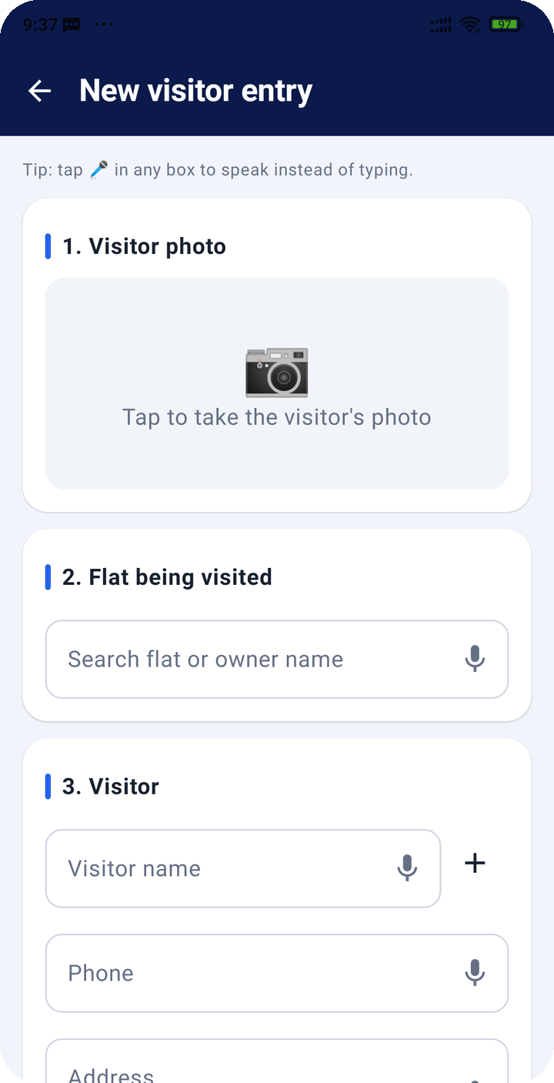
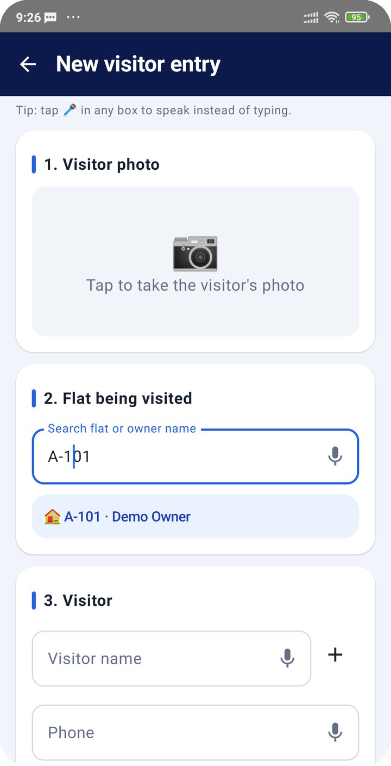
MOBILE APP · SECURITY GUARD
At the gate, a visitor is recorded in five quick steps
● Opens straight to the gate. Guards land on their community with today’s numbers.
● Smart flat search. A101, A 101 and A-101 all match; owner name works too.
● Owner instructions up front. “Call before entry” shows with a Call owner button.
● Flats & contacts. Every owner’s phone and the head’s rules, also offline.
Guard home
New visitor entry
Flat search
SuperGuard · Visitor management for gated communities
9

Slide 10
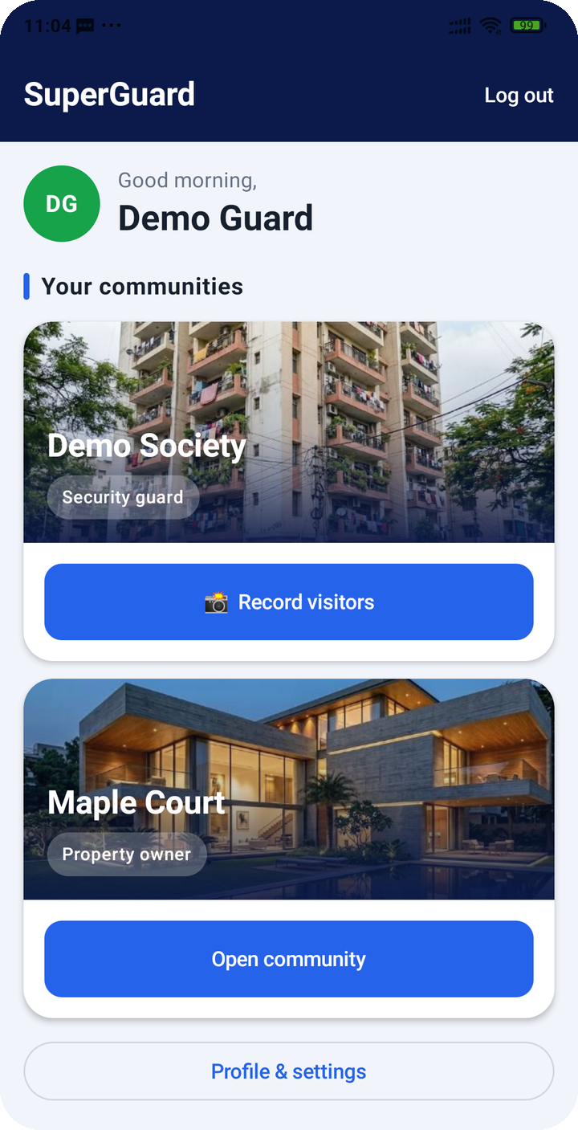
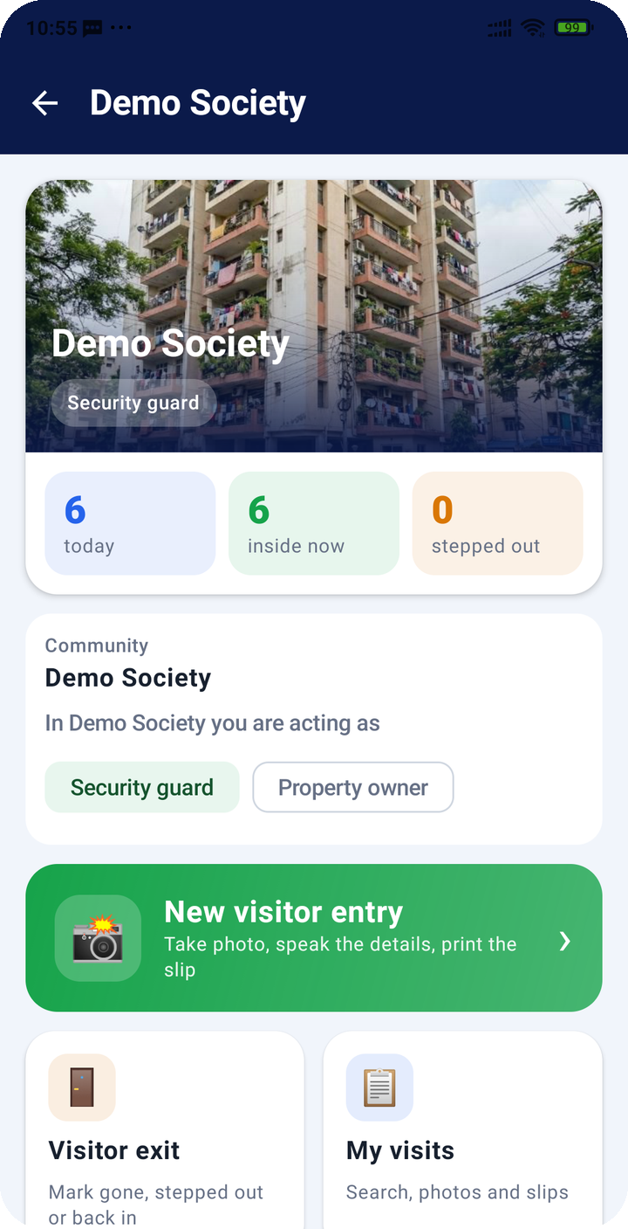
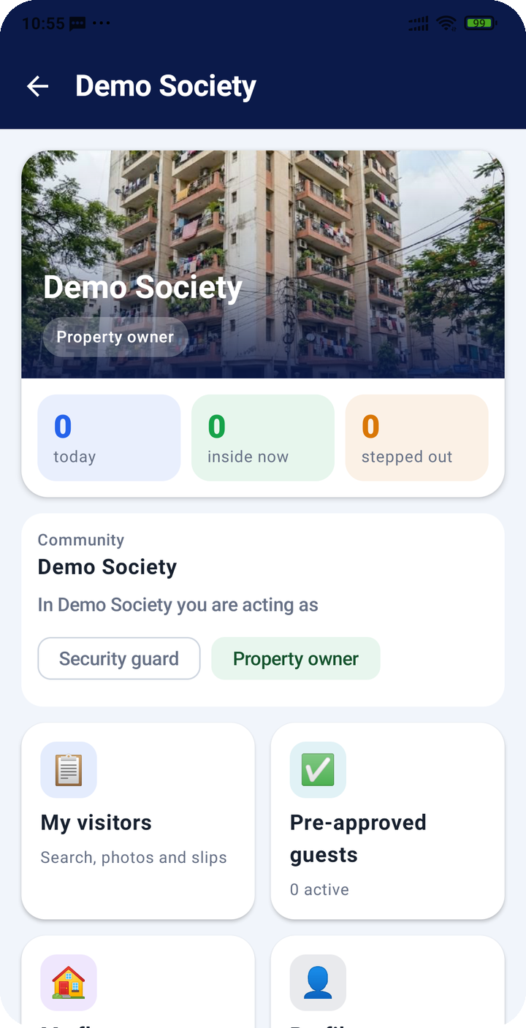
MOBILE APP · EVERY ROLE
One app for guards, owners, heads and staff
● Always shows where you are. The community and acting role sit at the top of the screen.
● Role switcher. Guard in the morning, owner at home: one tap changes the screens and lists.
● Content by access level. Owners see their visitors and guests; heads see members and numbers.
● Staff mode. Back-office users sign in for a read-only view.
All my communities
Switch role in place
Owner view
SuperGuard · Visitor management for gated communities
10

Slide 11
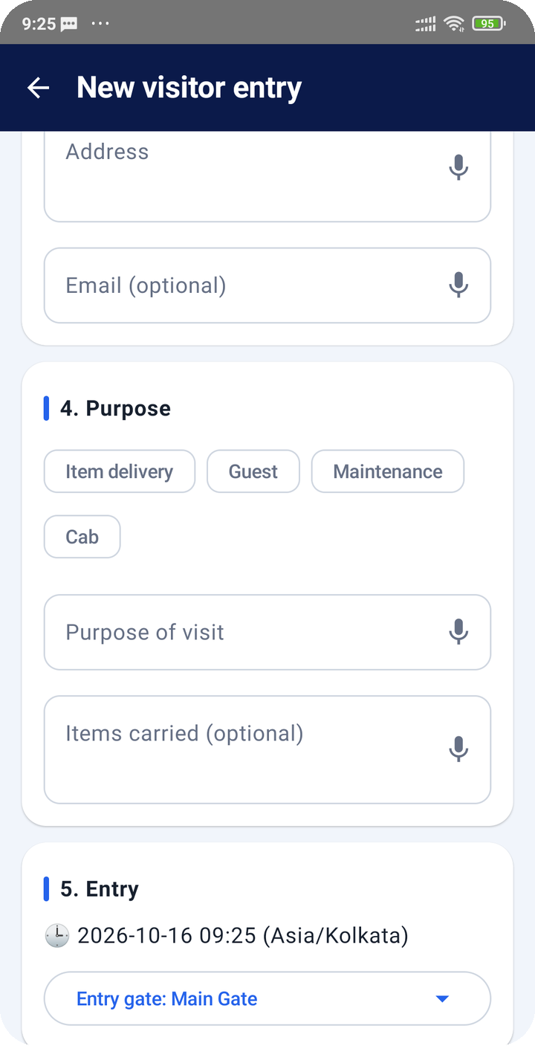
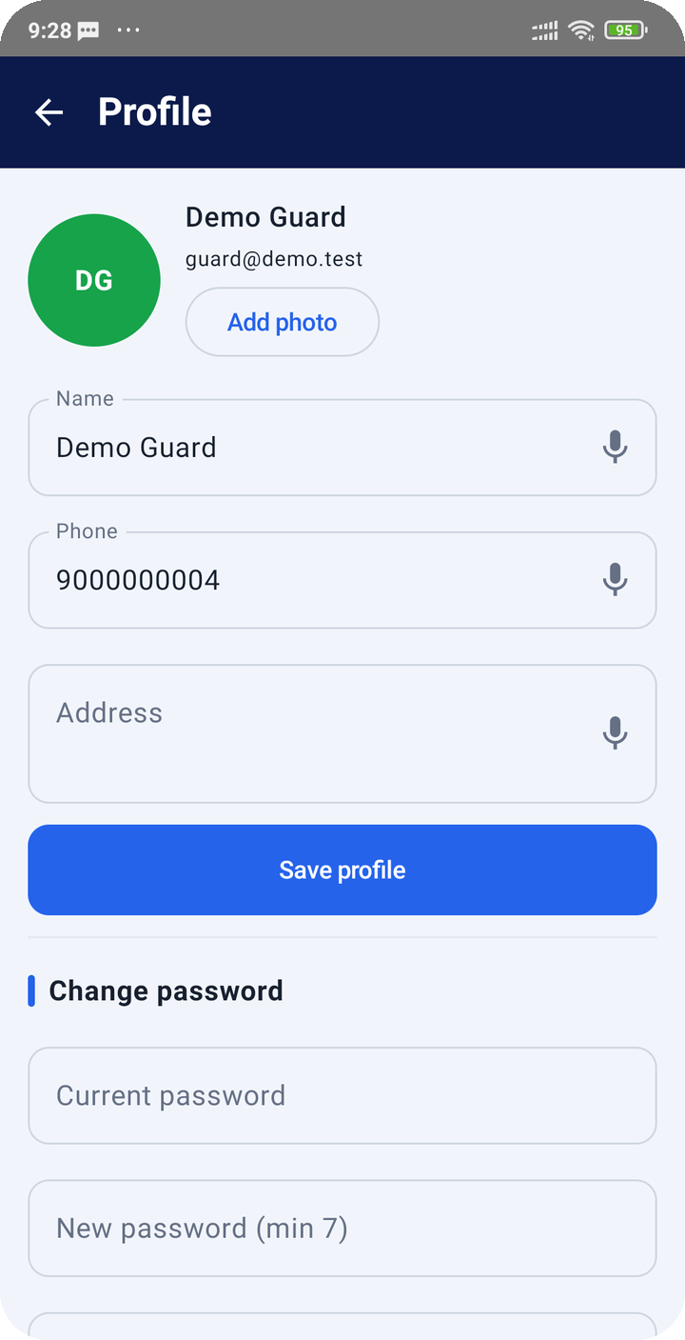
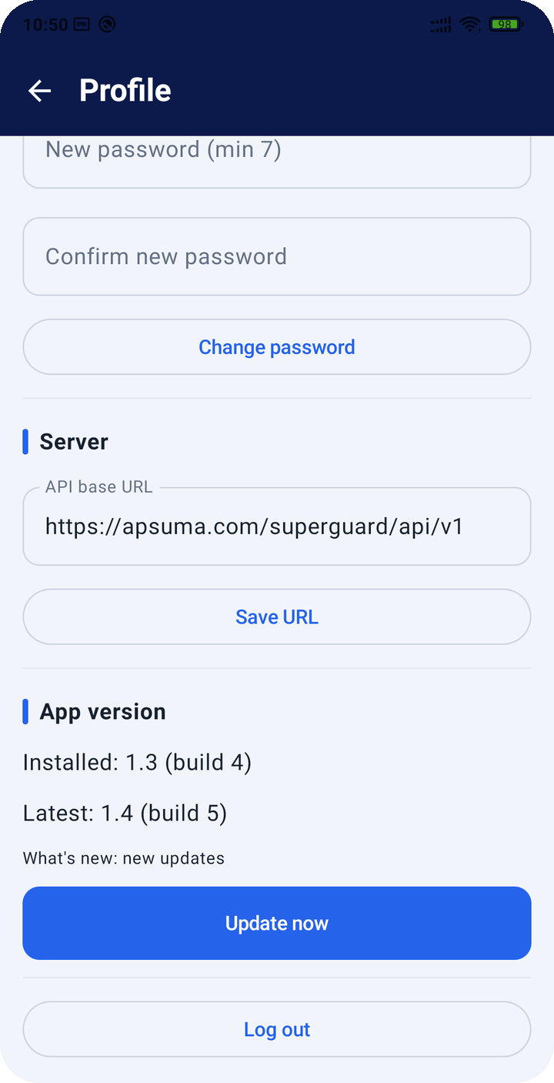



MOBILE APP · EVERYDAY USE
Made for patchy networks and busy shifts
Offline queue
Shows “waiting to sync” and uploads by itself.
Voice typing
Microphone in every text box.
Update pop-up
New versions are offered on any screen.
Built-in help
Opens the user guide at the right section.
Purpose chips and voice
Profile and photo
Version and updates
SuperGuard · Visitor management for gated communities
11

Slide 12
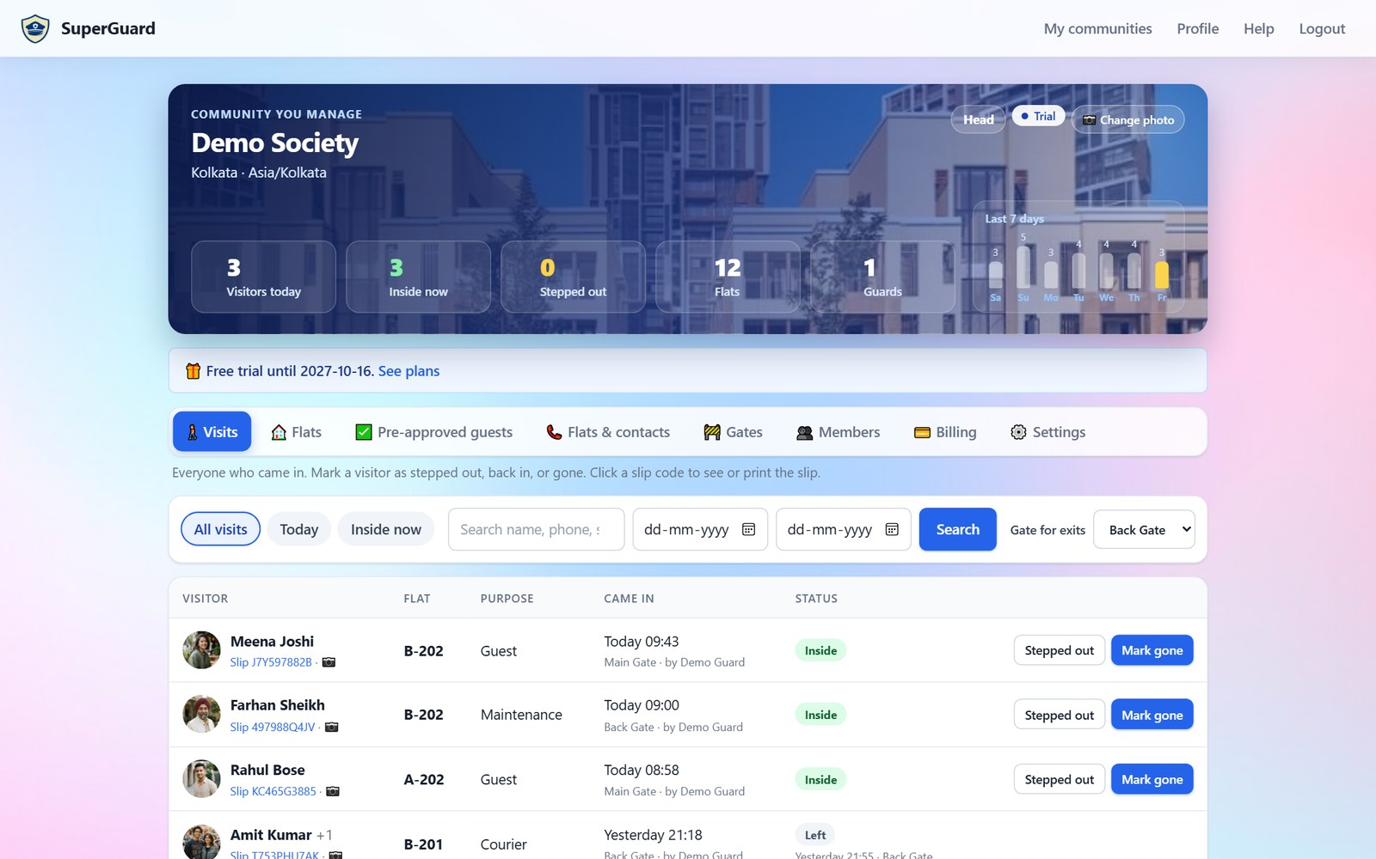


WEB APP · COMMUNITY DASHBOARD
Live numbers and every visit, with photos
Live counters
Visitors today, inside now, stepped out, flats and guards.
Search and filter
By name, phone, slip, flat or date; mark exits from the desk.
Your building
Community photo and a trial or plan banner.
SuperGuard · Visitor management for gated communities
12

Slide 13
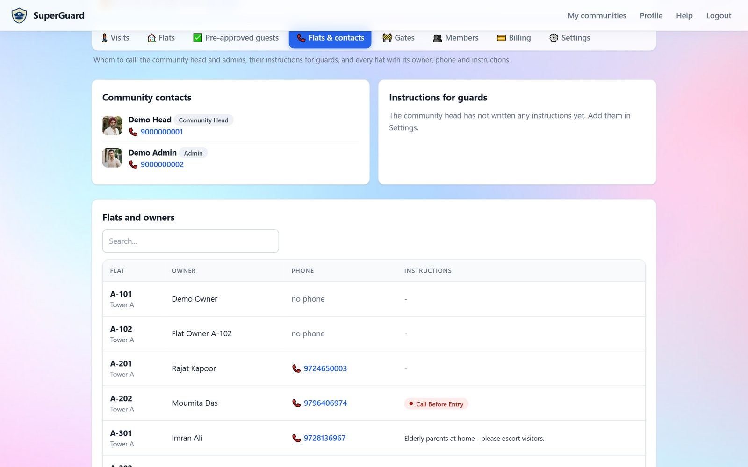
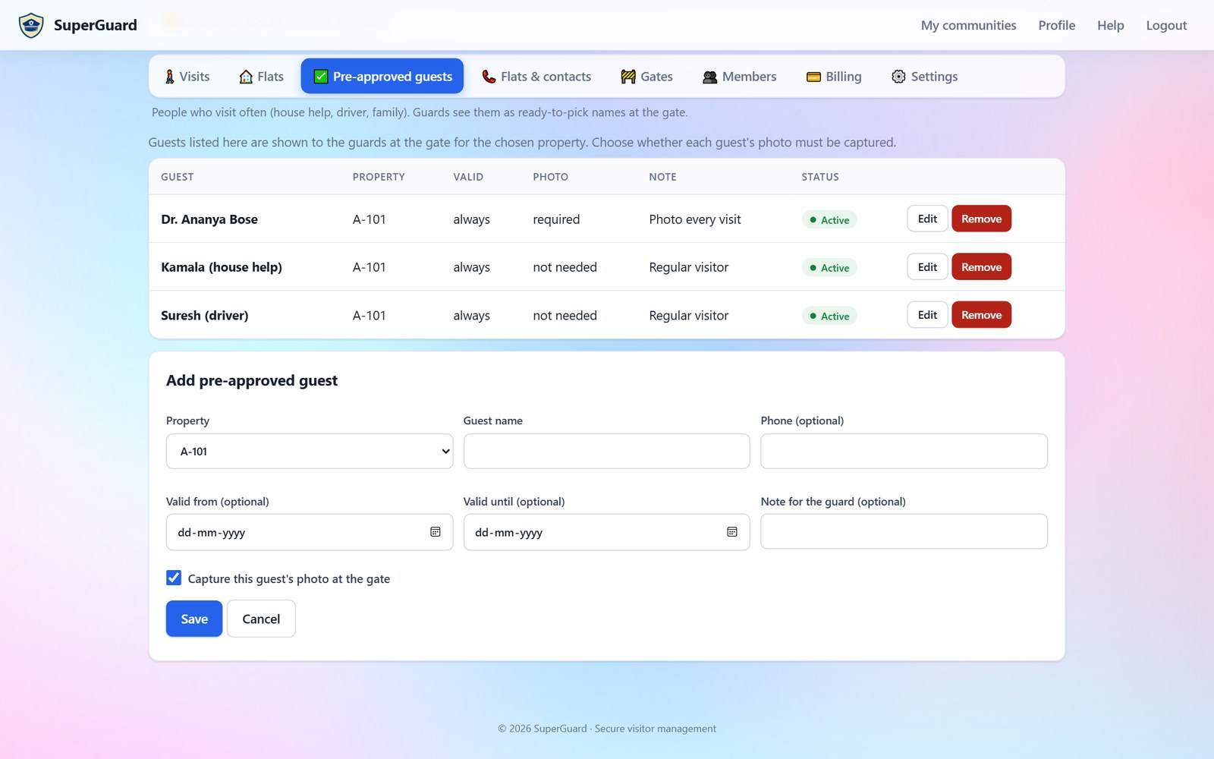
WEB APP · FLATS, CONTACTS AND GUESTS
Whom to call, and who is welcome
Flats & contacts: community heads, guard instructions and every owner’s phone
Pre-approved guests: house help, drivers and family, with photo rule and valid dates
SuperGuard · Visitor management for gated communities
13

Slide 14
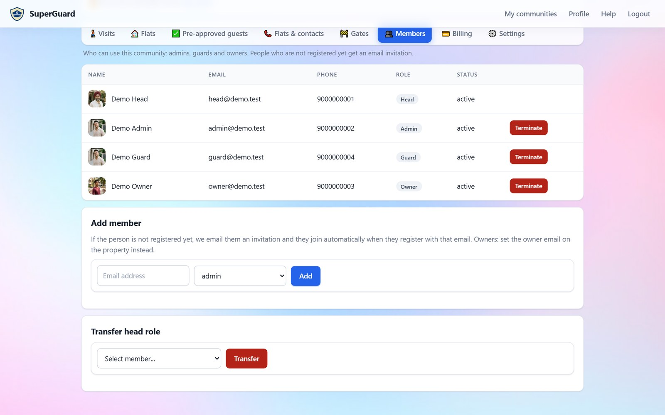
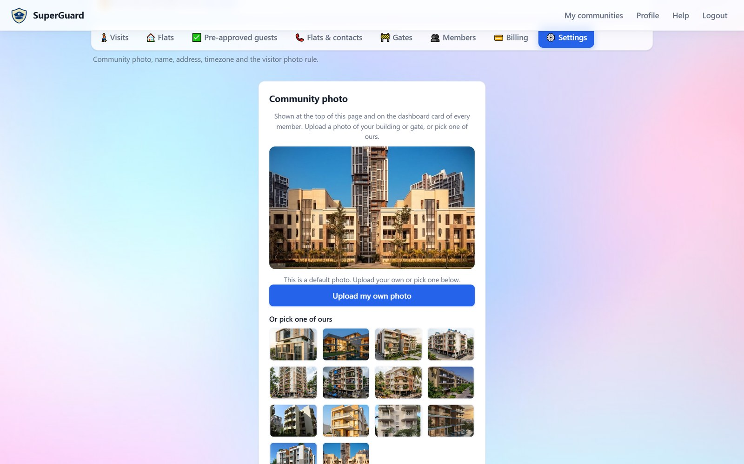
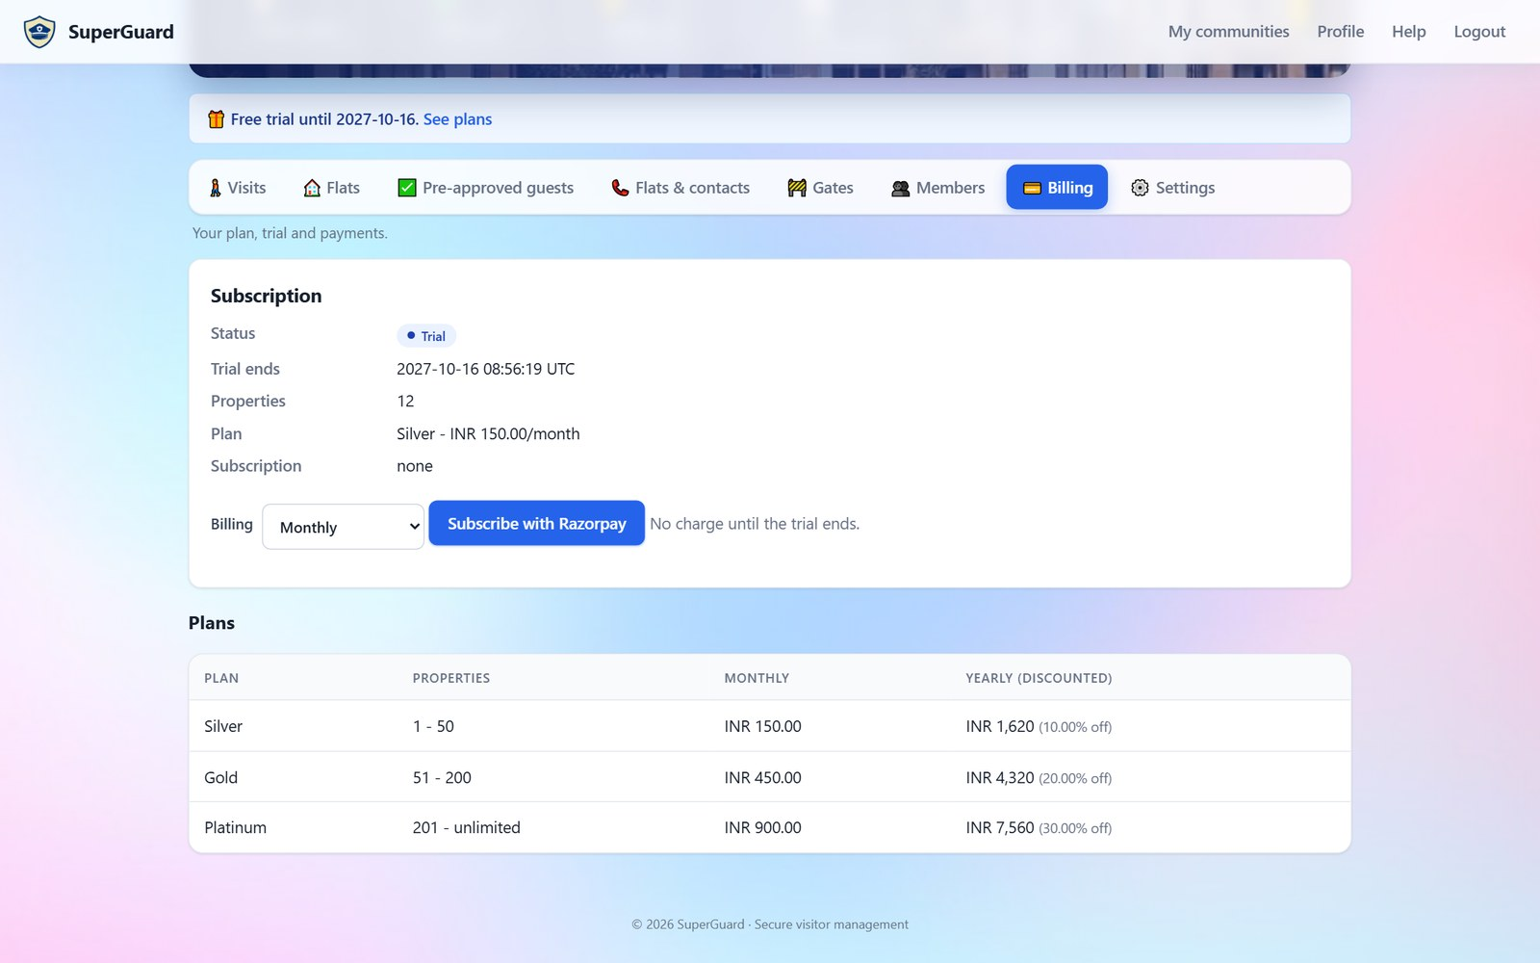

WEB APP · RUNNING THE COMMUNITY
Members, settings and billing in one place
Members
Settings
Billing
Add guards, owners and admins by email; invitations for new people.
Building photo, guard instructions, mandatory visitor photo.
Trial status, plan and Razorpay subscription, monthly or yearly.
Every change by a head or admin is written to the community audit log.
SuperGuard · Visitor management for gated communities
14

Slide 15
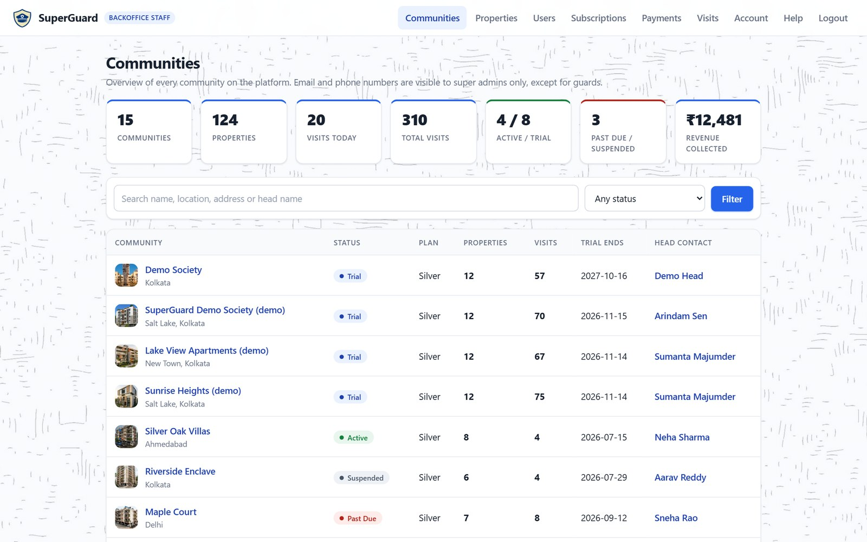

WEB APP · BACK OFFICE
Staff see every community, with privacy built in
Platform at a glance
Communities, properties, visits today, trials and revenue.
Search everything
Communities, flats, owners, users and visits with photos.
Privacy by role
Back-office staff see guard contacts only; super admins see all.
SuperGuard · Visitor management for gated communities
15

Slide 16

PRICING
Pay by the size of your community, after a free month
Silver
Gold
Platinum
1 – 50 flats
51 – 200 flats
201+ flats
₹150 /month
₹450 /month
₹900 /month
₹1,620 a year (10% off)
₹4,320 a year (20% off)
₹7,560 a year (30% off)
Unlimited guards, gates and visits
Unlimited guards, gates and visits
Unlimited guards, gates and visits
Every community starts with a 1-month free trial, with no card needed. Payments by Razorpay: cards, UPI and net banking.
SuperGuard · Visitor management for gated communities
16

Slide 17

GET STARTED
Make your gate smarter this week
Sign up at apsuma.com/superguard
Create the community, add gates and flats.
Invite your team
Guards, admins and owners join by email.
Install the app at the gate
Download for Android from the website and sign in.
User guide: apsuma.com/superguard/help

