Slide 1

SPlug
Smart plugs that look after your battery
Charge-aware automation for phones and laptops, with remote control, schedules and history on Android, Windows and the web.
apsuma.com/splug
Your plug has opinions about 100%

Slide 2
The problem: chargers never know when to stop
Leaving a lithium battery pinned at 100% on the charger wears it out faster
1
Overnight charging
2
Manual switching
Phones and laptops sit at full charge for hours. Heat and a constantly full battery shorten its life.
You must remember to unplug in time, and to plug back in before the battery runs flat.
3
Plugs that cannot see
4
No accountability
Ordinary smart plugs run timers only. They have no idea what the battery level is.
When a plug switched, nobody can say who or what did it: app, schedule or the button.
SPlug · Smart plugs that look after your battery
2

Slide 3
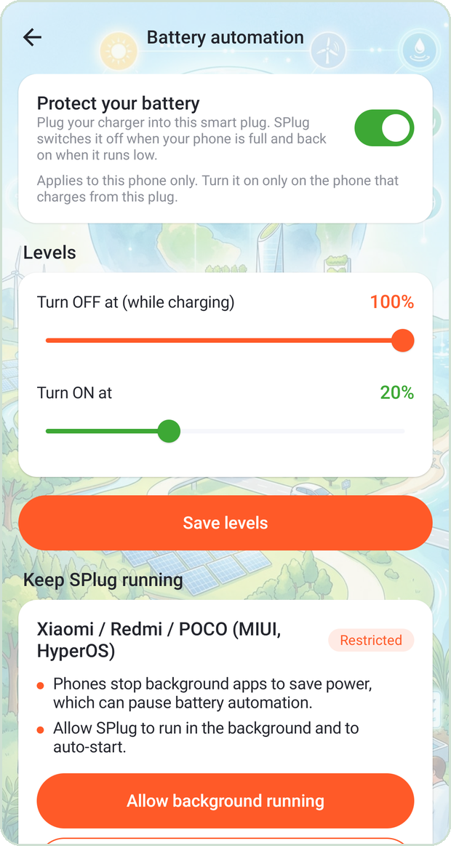
The answer: a plug that
reads the battery
SPlug links a Wi-Fi smart plug to the battery of the device it charges. It cuts power at your upper limit and restores it at your lower limit, automatically.
80%
20%
3
Switch OFF level
(you choose)
Switch ON level
(you choose)
Platforms:
Android, Windows, web
Battery automation screen on Android
SPlug · Smart plugs that look after your battery
3

Slide 4
Why SPlug is different
Most smart-plug apps are remote controls. SPlug makes decisions.
Capability
Typical plug app
SPlug
Reads the battery level of the charging device
No
✓
OFF at the upper limit, back ON at the lower limit
No
✓
Detects charging from another charger and backs off
No
✓
Phone, Windows laptop and web, one account
No
✓
History that says why: app, schedule, battery, plug button
No
✓
Schedules run on the server, phone can be off
Yes
✓
SPlug · Smart plugs that look after your battery
4

Slide 5
The logic: a simple, safe state machine
Edge-triggered, so it sends one command per event, never a stream of them
A. Reached the upper limit while charging
plugged in and level ≥ OFF limit
level drops, or power lost
ARMED
PLUG OFF SENT
RE-ARMED
watching battery level
power cut, battery rests
ready for next cycle
B. Reached the lower limit
level ≤ ON limit
level rises above the limit
ARMED
PLUG ON SENT
RE-ARMED
watching battery level
charging resumes
ready for next cycle
If someone switches the plug back on above the limit, losing power re-arms the rule so the plug is switched off again.
SPlug · Smart plugs that look after your battery
5

Slide 6
Built-in safeguards
Real homes have several phones, flaky Wi-Fi and aggressive battery savers
1
Retries with back-off
2
Charger check
3
One plug per device
Each command is tried up to 3 times, 2 s then 4 s apart. A failure just waits for the next check.
45 s after switching off, if the phone is still charging it is on another charger. The plug goes back on and automation pauses.
Each phone or PC protects one plug, so several devices on one account never fight each other.
4
Keeps running
5
Server-side schedules
6
Full audit trail
A foreground service restarts after reboot, with guidance for MIUI, Samsung, Oppo and other battery killers.
Timers run from the server's cron, so they fire even when your phone is off or out of battery.
Every switch is logged with its reason: app, schedule, battery automation, or the button on the plug.
SPlug · Smart plugs that look after your battery
6

Slide 7
How it fits together
One account, three ways in, one cloud path to the plug
Android app
Kotlin + Compose
SPlug server
Tuya Cloud
Windows app
PHP 8 REST API + MySQL
Cron: schedules, energy
apsuma.com/splug
OpenAPI
Plug
C# .NET 8 WPF
Wi-Fi
Web admin
Browser, any device
Phone only: Tuya App SDK talks to the cloud directly for pairing new plugs, scenes and Tuya's device panel.
Passwords stay on the SPlug server; Tuya never sees them. Each user gets an opaque session token.
SPlug · Smart plugs that look after your battery
7

Slide 8
Technologies used
1
Android app
2
Windows app
3
Backend
Kotlin, Jetpack Compose, MVVM, Retrofit, foreground service, Tuya Smart App SDK
C# on .NET 8, WPF, DPAPI-protected token, tray icon, single self-contained EXE
PHP 8.1, hand-written router and PSR-4 autoloader, MySQL, REST + bearer tokens, cron jobs
4
Smart-plug cloud
5
Web
6
Build and hosting
Tuya Cloud OpenAPI (signed requests) and the Tuya App SDK for pairing and scenes
Server-rendered PHP admin panel, CSRF-protected, CSP header, responsive layout
GitHub Actions build signed APK and EXE; shared cPanel hosting with SMTP for password-reset email
SPlug · Smart plugs that look after your battery
8

Slide 9
Supported platforms
Android
Windows
Web
Android 8.0 and newer
Windows 10 / 11, 64-bit
Any modern browser
Full feature set: pairing, scenes, battery automation, energy, alert tones
One EXE, no installer or .NET needed. Laptop battery automation, tray, autostart
Admin panel, account sign-up, password reset by email, app downloads
Hardware: Tuya-based Wi-Fi smart plugs (socket category), including models with power monitoring.
Not yet: iPhone and macOS.
SPlug · Smart plugs that look after your battery
9

Slide 10
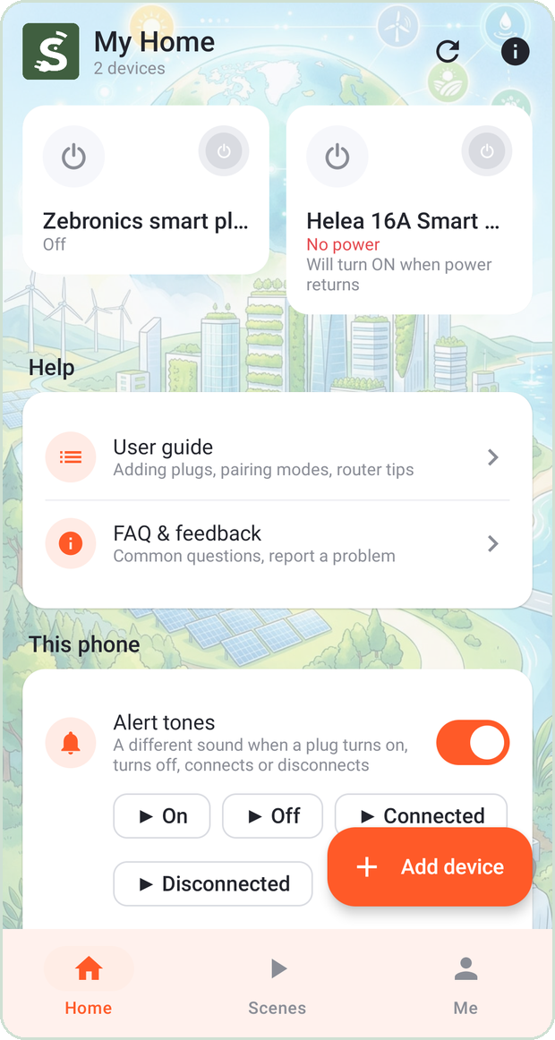
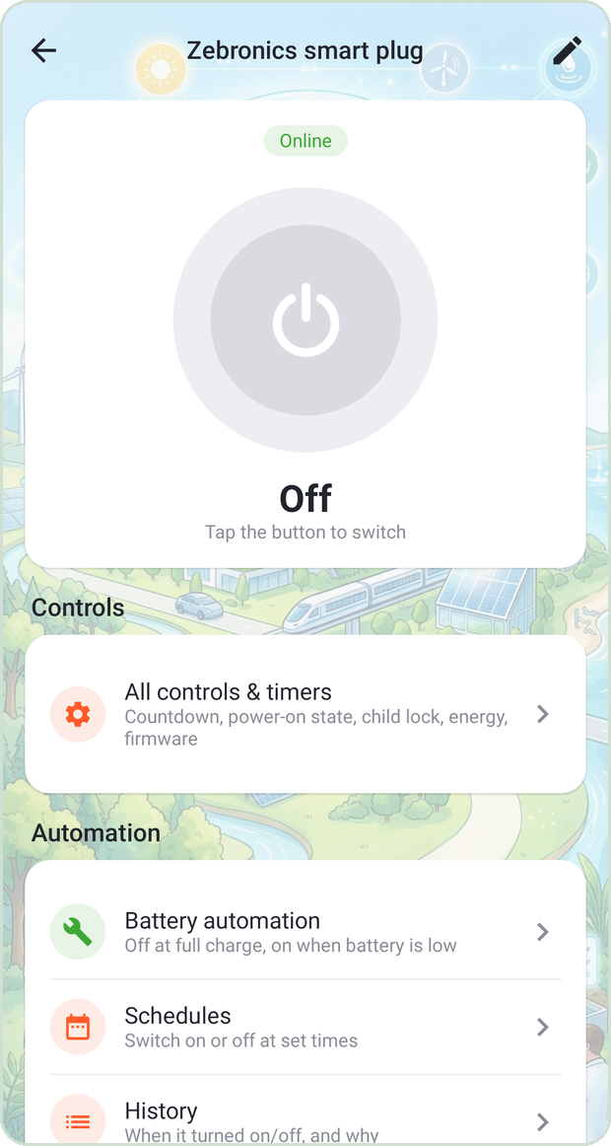
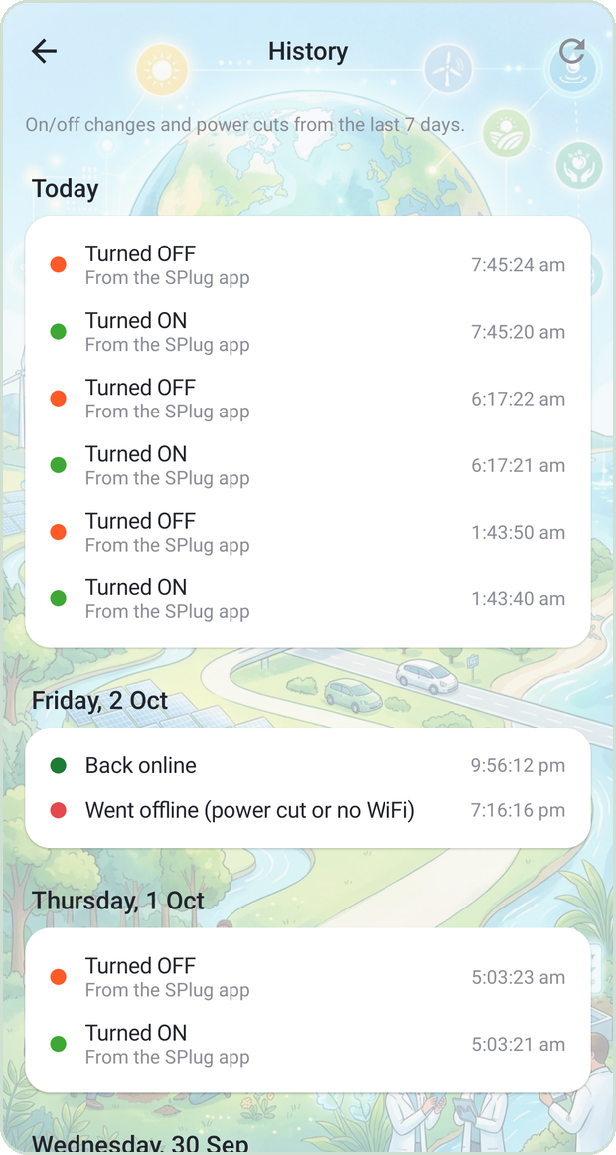
Mobile app
Everything about a plug, one tap away
Home
Plug control
Battery automation
History
Plug cards, quick on / off, alert tones
Big power button, timers, automation
Set your OFF and ON levels
Every switch, with the reason
SPlug · Smart plugs that look after your battery
10

Slide 11
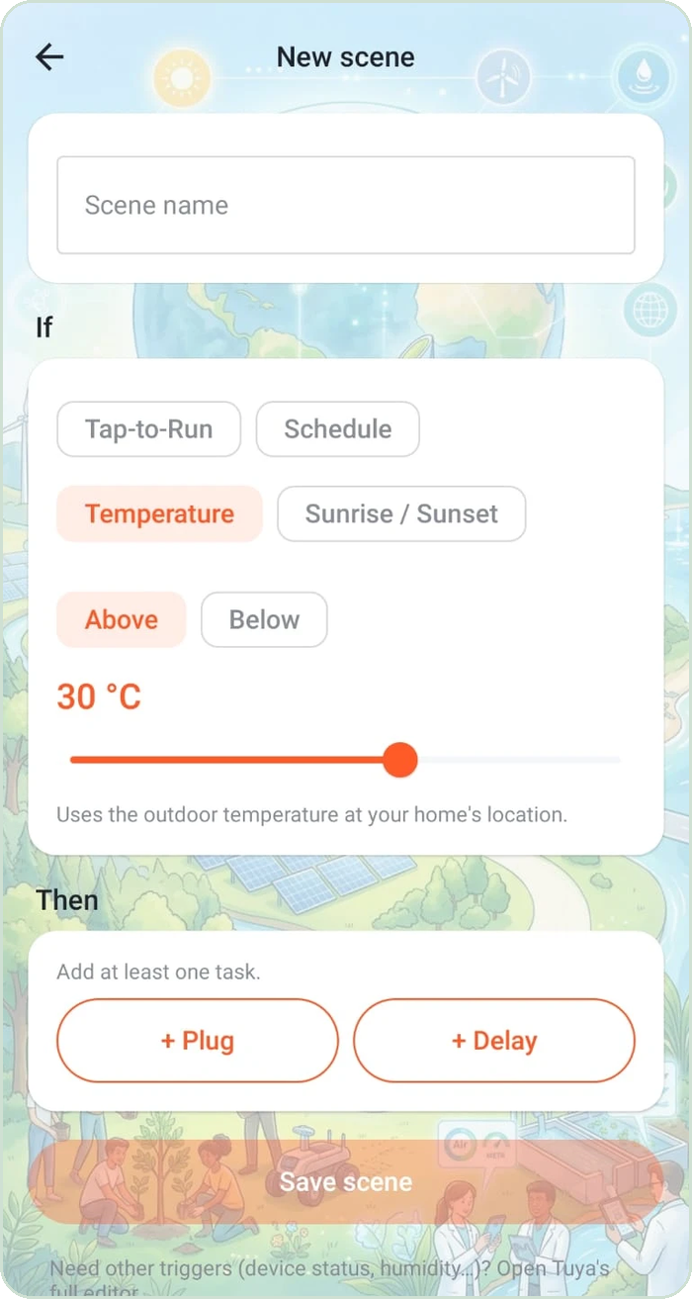
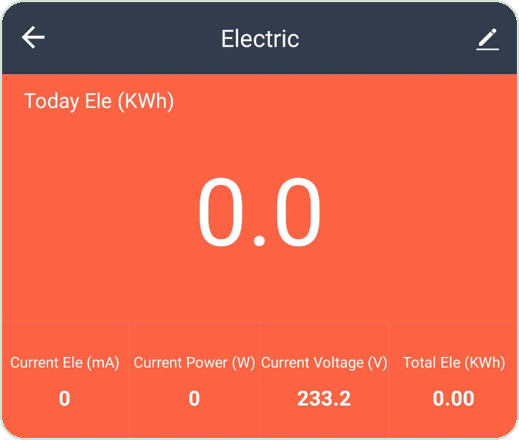
More on the phone
Pair new plugs BLE + Wi-Fi or AP mode, guided
Scenes and automations temperature, sunrise, schedule, tap-to-run
Energy monitoring power, voltage, current, kWh
Schedules on / off at set times and days
Energy dashboard
Alert tones four sounds for on, off, connected, disconnected
Guides built in user guide, FAQ and OEM battery-saver tips
Scene editor
SPlug · Smart plugs that look after your battery
11

Slide 12
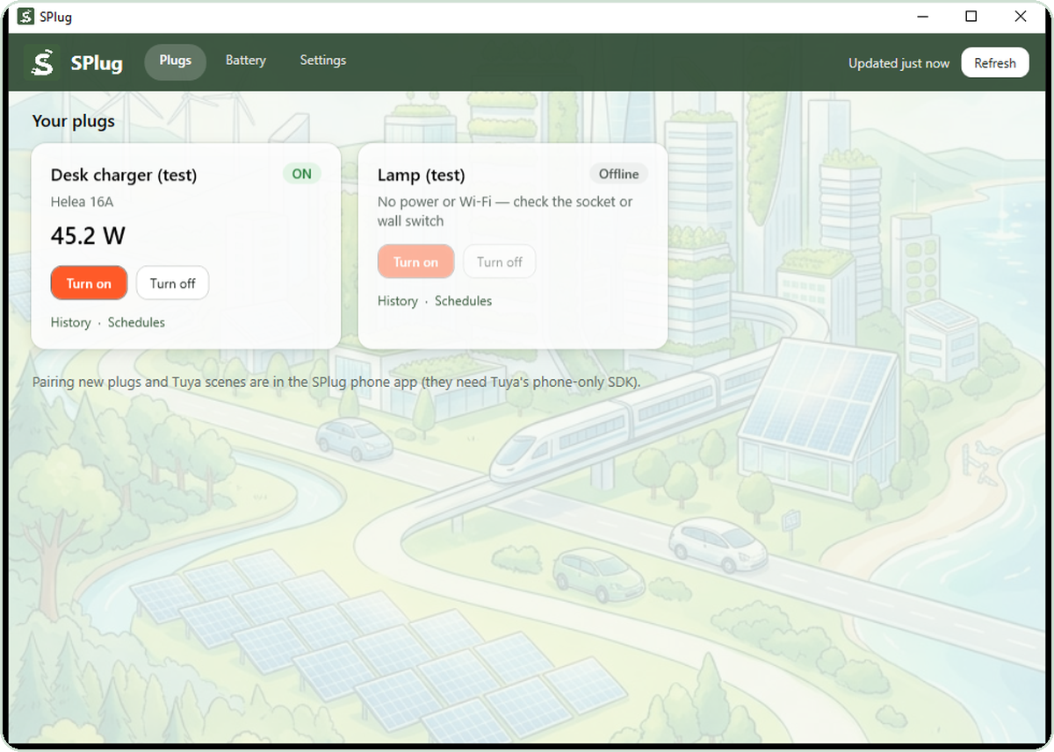
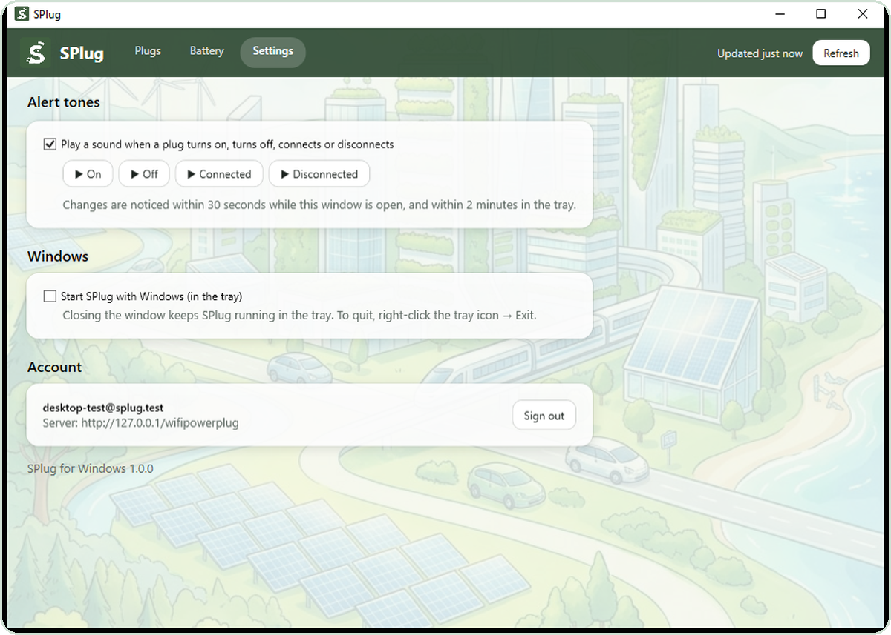
Windows app
The same account on your desktop, and your laptop's battery protected too
Plug cards live state and power in watts
Tray menu on / off per plug, runs in background
Laptop battery automation same rules and safeguards
History and schedules for every plug
Alert tones and start with Windows
One EXE Windows 10/11, no install
SPlug · Smart plugs that look after your battery
12

Slide 13
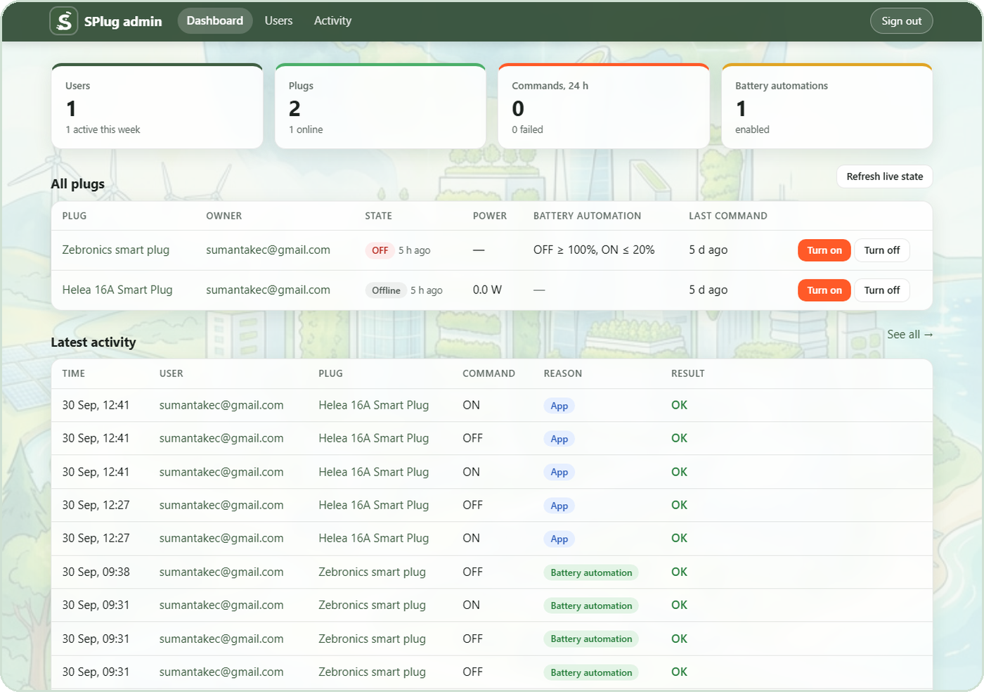
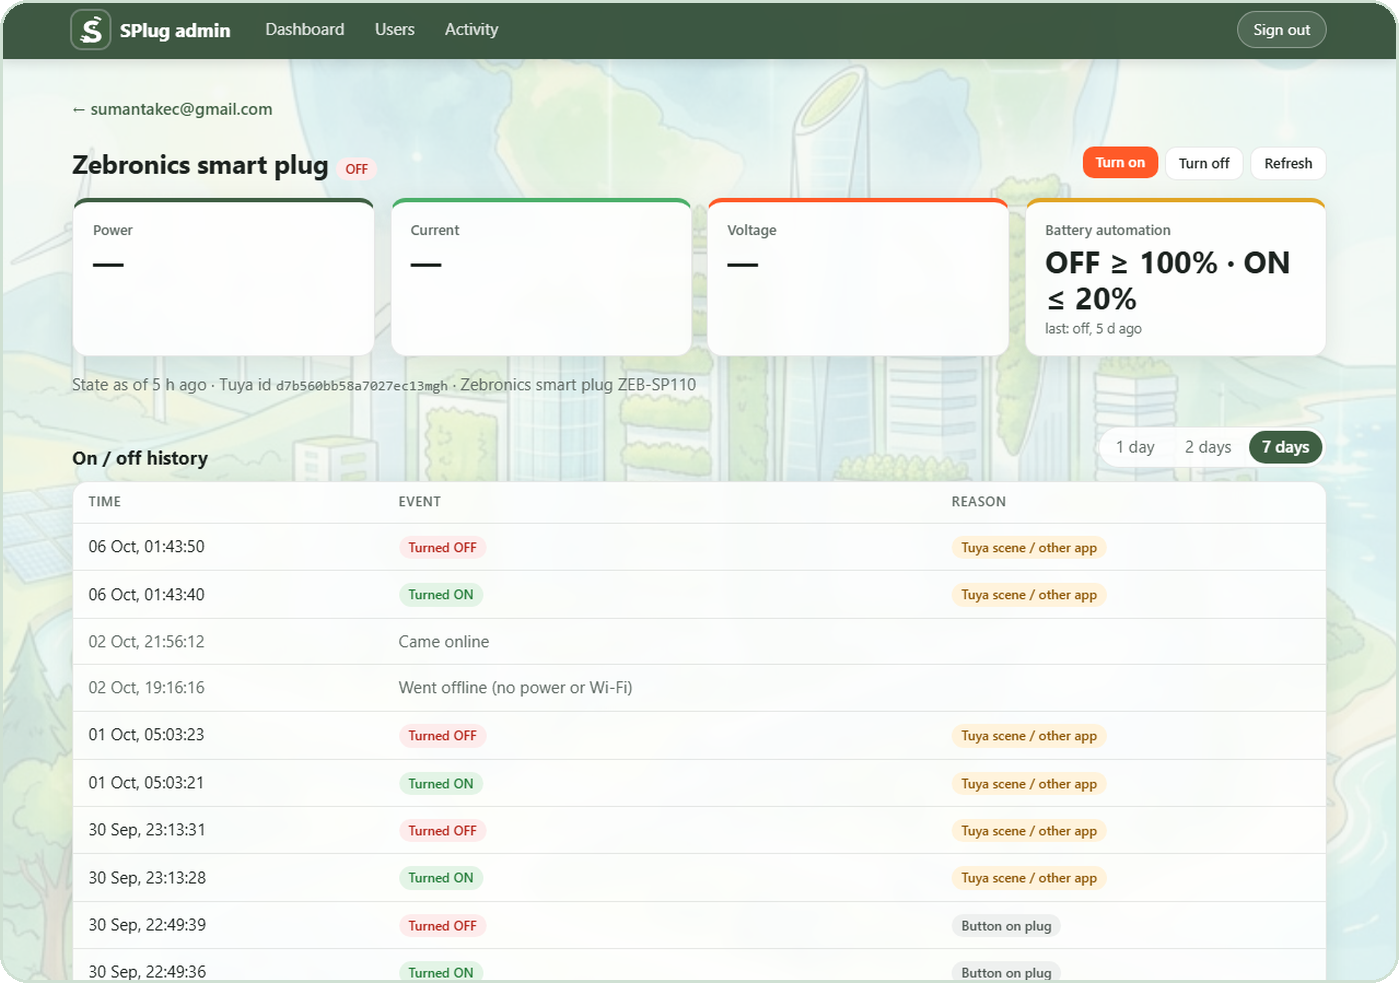
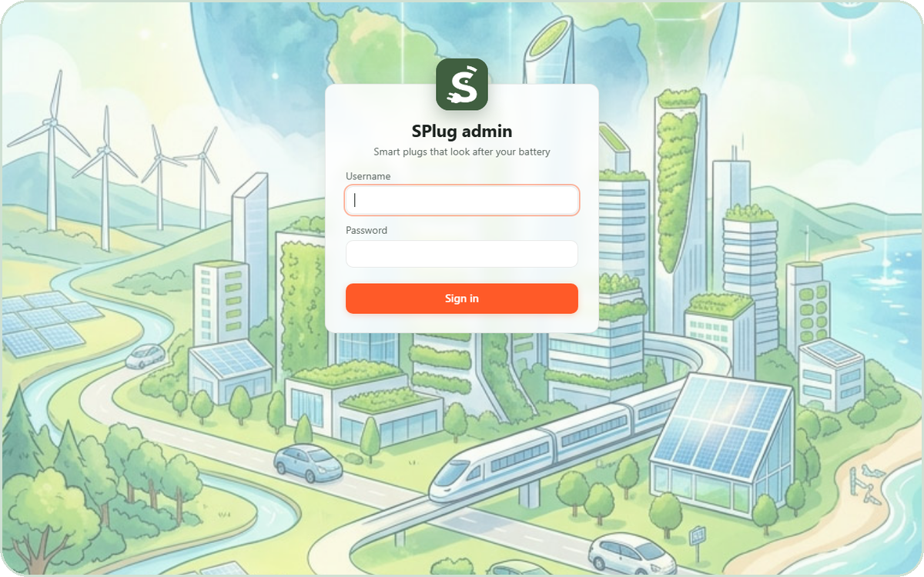
Web admin panel
See every user, plug and switch from any browser
Dashboard users, plugs online, commands, automations
Plug page live state, remote on / off, history with reasons
User control disable, sign out, reset password
Clear history per user or for everyone
Public site: app downloads, create account, and forgot-password email reset.
SPlug · Smart plugs that look after your battery
13

Slide 14
Charge smarter.
Protect every battery.
Download SPlug for Android or Windows, create your account and pair a plug in minutes.
apsuma.com/splug
Thank you

