Slide 1
RS Stetho
BLUETOOTH DIGITAL STETHOSCOPE
Record, visualize and screen heart & lung sounds — on any phone or browser.
Product overview · October 2026
ESP32 · INMP441 · Web · Android
Notes:
RS Stetho is a low-cost Bluetooth digital stethoscope: an ESP32 with a MEMS microphone streams heart and lung sounds to a phone app and a website, where they are recorded, graphed and screened. This deck walks through what it does and why it matters. Everything shown is real and working today.

Slide 2
A stethoscope that remembers, shows and shares
THE IDEA
A traditional stethoscope is analog and momentary — the sound is gone the instant you lift it. RS Stetho turns every auscultation into a record you can see, measure, replay and send.
Affordable
Connected
Objective
Built from an ESP32 and a MEMS microphone — a small fraction of the cost of a commercial digital stethoscope.
Streams over Bluetooth to a phone or a browser. No cables and no proprietary dock to carry.
Fleeting sounds become waveforms, spectrograms and screening metrics that anyone can review later.
Notes:
The core pitch: capture, persistence and sharing, at commodity-hardware cost.

Slide 3

Three parts, one signal path
HOW IT WORKS
01 · Device
02 · Connect
03 · Record & screen
Chest piece
Bluetooth
App & web
An ESP32 and an INMP441 MEMS microphone in a 3D-printed housing digitize the body sound.
The sound streams live over Bluetooth Low Energy to the Android app or the website.
Save it on your device, graph it, and read automatic heart and lung indicators.
Notes:
The architecture in one line: MEMS mic to ESP32 to BLE to app and web to records and screening.

Slide 4
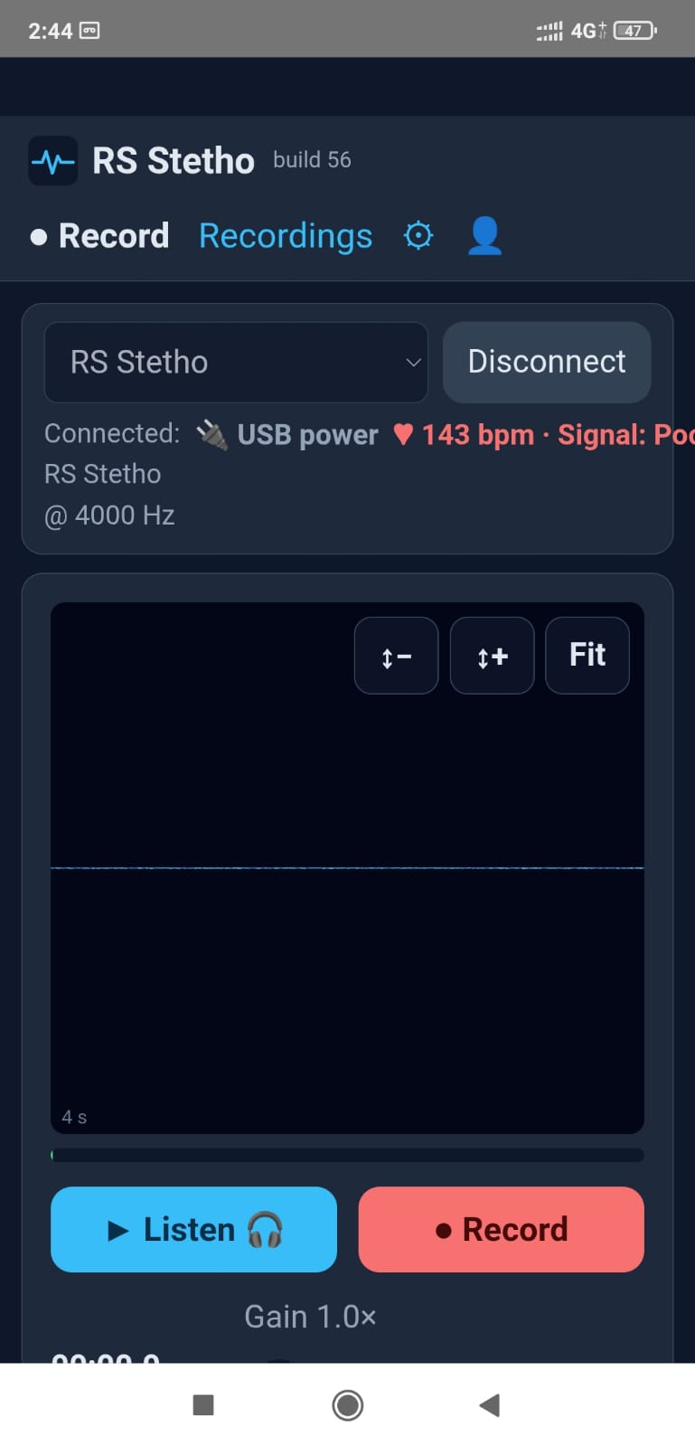
Record in seconds
CAPTURE
Connect over Bluetooth, place the chest piece, and listen live through headphones.
Live coaching shows the heart rate and signal quality as you go — Good, Fair or Poor, with tips like “press firmer”.
Hold still for 15–30 seconds, press stop, and save — so you get a clean capture every time.
Notes:
The live signal-quality readout is the coaching feature: it tells the user when the recording is good before they rely on it.

Slide 5
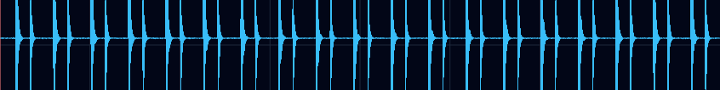
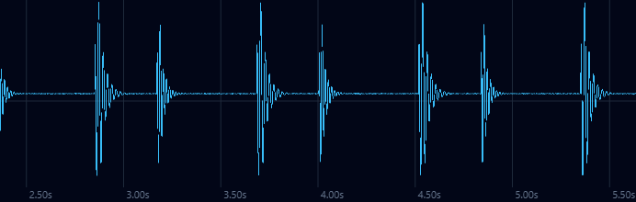
See every beat
VISUALIZE
Zoom and pan the trace — scroll or pinch — down to a single lub–dub.
Filters isolate the heart band (25–400 Hz), the lung band, or show raw.
Play it back at any volume, then export the exact view as an image or share the audio.
Zoomed to individual beats — S1 then S2
Notes:
Zoom, filters and playback; the share image exports exactly the view on screen, and the audio can be shared too.

Slide 6

Automatic screening indicators
ANALYSIS
HEART RATE
RHYTHM
S1–S2 TIMING
72 bpm
Regular
320 / 515
From the spacing of the heart sounds.
Beat-to-beat variability; flags irregular.
Systole · diastole, in milliseconds.
MURMURS
LUNGS
SIGNAL QUALITY
Screened
Resp + sounds
Good
Systolic & diastolic, graded by intensity.
Respiratory rate, wheeze and crackle screen.
Good / Fair / Poor, with the reason.
Screening indicators to guide the ear — not a diagnosis. On a noisy capture they are muted and flagged, so a poor signal never reads as a finding.
Notes:
Six indicators, computed on the device from the audio. The caution is built into the product, not just the slide: findings are down-weighted when the signal is not Good.

Slide 7
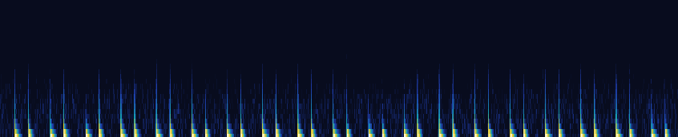
Hear with your eyes
SPECTROGRAM
Beats
Murmurs
Lung sounds
Evenly-spaced bright columns near the bottom — one per heartbeat.
Show up as a brighter haze filling the gap between the beats.
Wheezes as horizontal streaks; crackles as scattered flecks. Follows the filter.
Notes:
Time runs left to right, frequency bottom to top, brighter is louder. This is the clean demo recording: regular columns, no haze.

Slide 8




Private by design
TRUST
On your device
Only our apps connect
Audio stays on the doctor's phone or computer. The server keeps only the details, the file name and a 24-hour copy for viewing.
The device verifies the RS Stetho app with a cryptographic handshake before it streams a single sample.
One account, one device
Admin console
Email is the login. A new sign-in signs out the previous browser or phone, so an account is never open in two hands.
Manage users, reset passwords, enable or disable accounts, and put the site into maintenance — on web and in the app.
Notes:
Privacy, device binding, single-session accounts and administration — the trust story.

Slide 9






Built to be used, every day
WHY IT MATTERS
Cross-platform
Shareable
Telemedicine-ready
Android app and website, one shared account and the same features.
Send a waveform image or the audio itself for a quick second opinion.
Capture at the bedside, review it anywhere — the record travels.
Searchable records
Affordable & open
A screening aid
Every file named Patient_ID_Date_Site — find any recording in seconds.
Commodity parts and your own server — your hardware, your data.
Surfaces findings worth a closer listen, so nothing quiet gets missed.
Notes:
The benefit summary, one card per selling point. Keep it concrete.

Slide 10
Every heartbeat — recorded, seen and shared.
RS STETHO
An affordable, connected stethoscope that makes auscultation a record, not a moment.
Dedicated with gratitude to Dr. Rajib Sarkar, Kolkata.
Notes:
Closing statement and the project's dedication.

