Slide 1

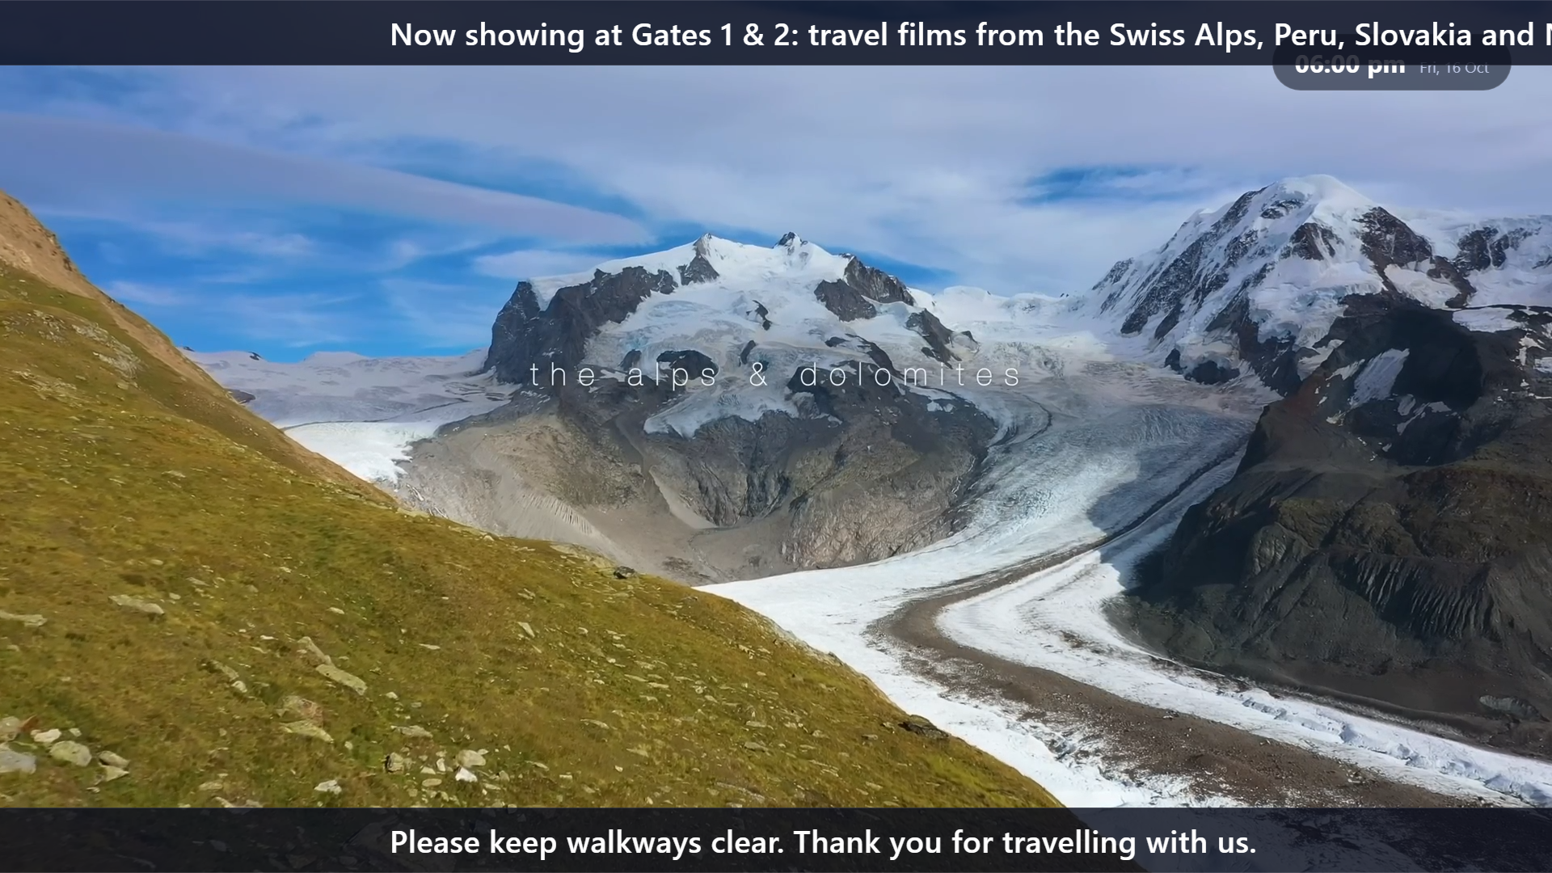
AAIIDS · SIGNAGE CONTROL
Every screen.
One dashboard.
Live in seconds.
A web-based digital signage system for stations, airports and transport hubs, built for Samsung Smart Signage TVs.
Any TV browser
Desktop & mobile
Self-hosted
Product overview · October 2026
Notes:
Introduce AAIIDS: a web-based CMS that controls every signage TV in a transport hub from one place.

Slide 2




THE PROBLEM
Transport screens are hard to keep current
WITH AAIIDS
30 s
Content updated by hand
Information goes stale
Staff carry USB sticks from screen to screen, so one timetable fix can take hours.
Delays, gate changes and offers reach the screens late, or never.
longest any TV waits to pick up a change
1 URL
No way to interrupt
Costly lock-in
per TV. Nothing to install on the screen itself
In an emergency there is no quick way to take over every screen at once.
Commercial signage suites charge per screen and need extra players or cloud accounts.
AAIIDS · sams_tvaai signage
2
Notes:
Most hubs still update screens by hand, so information lags behind reality exactly when passengers need it most.

Slide 3




THE SOLUTION
One web app drives every screen
Operators
AAIIDS server
Signage TVs
Admins and editors use any browser, on a laptop or a phone
PHP 8 + MySQL on your own PC (XAMPP) or shared hosting (cPanel)
Each Samsung TV's URL Launcher opens its own player link
TVs check in every 30 seconds. No app on the TV, no cloud subscription, no per-screen licence. Change something in the dashboard and every screen it targets updates on its next check-in.
AAIIDS · sams_tvaai signage
3
Notes:
Editors work in a browser on a laptop or phone. The server stores content and schedules. Each TV just opens its own player link.

Slide 4






WHY IT'S UNIQUE
What makes it different
One-click live override
Slides without a designer
Live voice broadcast
Push an urgent announcement to one TV, a group or every screen. It interrupts at once and ends on schedule.
Timetable, offer, announcement and custom templates. Fill in a form and it looks finished.
Speak into the admin page and your voice plays on the chosen TVs a few seconds later.
Slides that speak
Different video per TV
Yours to own
Text-to-speech uses the TV's own voice engine, so there are no cloud keys or fees.
A different full-length film on each screen, with sound switched on per TV.
Plain PHP + MySQL on your own server or cheap hosting. No vendor lock-in.
AAIIDS · sams_tvaai signage
4
Notes:
Six things that set AAIIDS apart from a plain media player or a generic signage subscription.

Slide 5
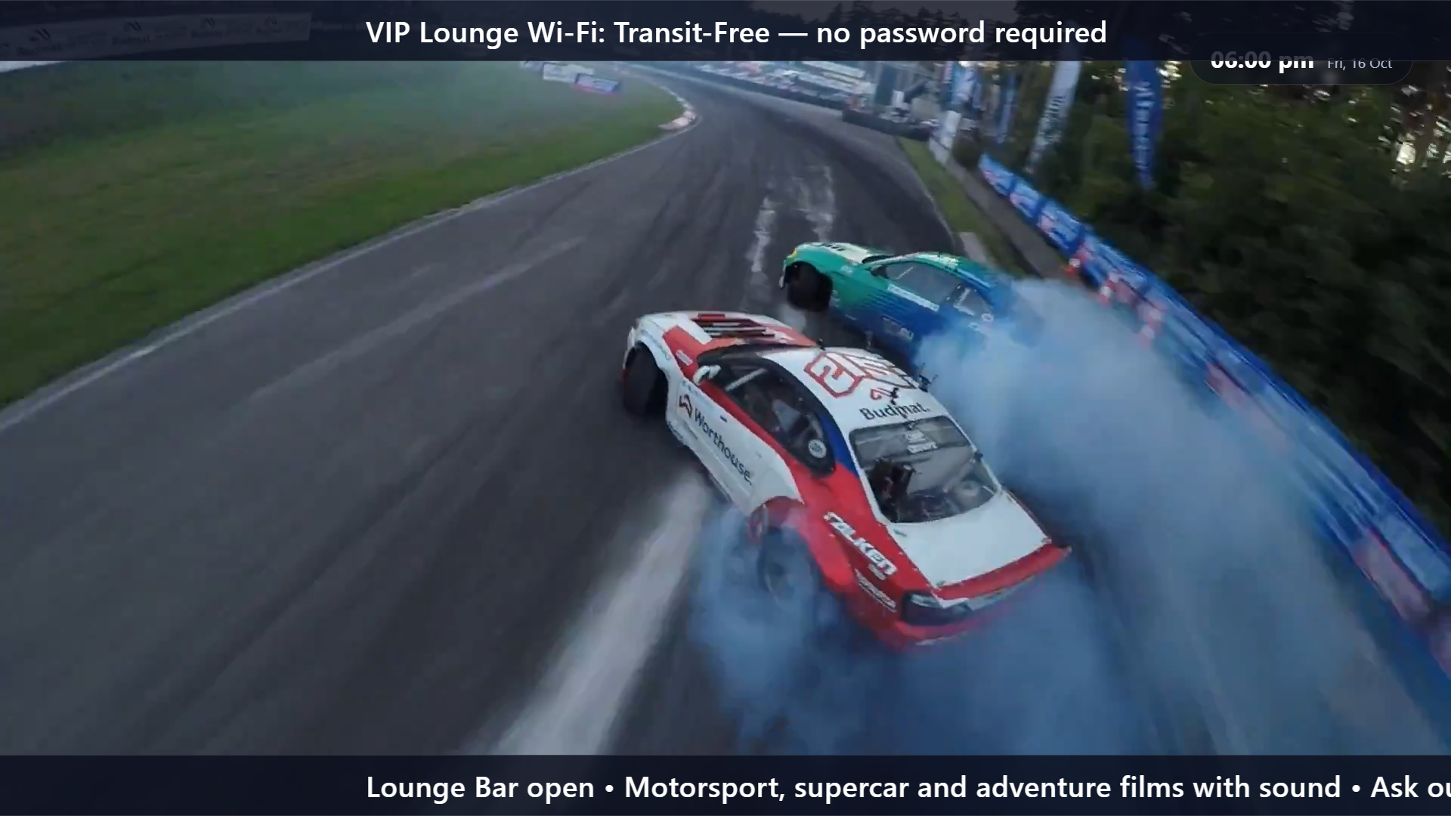
CORE LOGIC
How a TV decides what to show
1
Live announcement
An active override for this TV or its group always wins, within its start and end time.
if none ↓
2
Scheduled playlist
Otherwise, the highest-priority schedule in its time window. On a tie, a TV-specific schedule beats a group one.
if none ↓
Always layered on top, in every mode
3
Nothing scheduled
Marquee ticker top or bottom, per TV or group
Live broadcast voice audio over whatever is playing
Clock always Indian Standard Time, whatever the TV is set to
A calm empty-state screen, never a blank or error page.
AAIIDS · sams_tvaai signage
5
Notes:
Every 30 seconds each TV asks the server what to play. The answer follows a strict order: live override, then the best schedule, then a friendly empty screen.

Slide 6








CORE LOGIC
Inside the TV player
Opens once
Checks in
Builds the loop
Plays smoothly
Updates politely
TV loads its player link with a private access token
Asks the server what to play every 30 seconds
Videos, photos, slides and PPT/PDF pages in order
Cross-fades; photos on a timer, videos play to the end
Urgent changes switch now; normal edits wait for the loop
Sound per TV
Online status
Override first
If a TV blocks autoplay with sound, it plays muted and shows “press OK to turn on sound”.
Each check-in updates the TV's last-seen time, shown as Online or Offline on the dashboard.
Entering or leaving a live announcement swaps instantly, even mid-video.
AAIIDS · sams_tvaai signage
6
Notes:
The player is a single web page. It loads once, then polls and plays on its own for days without anyone touching the TV.

Slide 7
TECHNOLOGY
A simple, durable stack
0
0
0
Plain PHP and MySQL on the server, plain JavaScript in the browser. Open it in any editor and it just runs.
frameworks
build steps
cloud API keys
PHP 8
MySQL / MariaDB
HTML5 · CSS3 · JS
HTML5 video & audio
Server logic, no framework
PDO with prepared statements
Admin and player, no build
MP4, WebM, MP3, AAC, WAV
Web Speech API
MediaRecorder API
LibreOffice + Imagick
Built-in SMTP & XLSX
Text-to-speech on the TV
Mic recording and broadcast
PPTX and PDF to slides
Mail and Excel, no libraries
AAIIDS · sams_tvaai signage
7
Notes:
Deliberately framework-free so it runs on cheap hosting and stays easy to maintain for years.

Slide 8



SUPPORTED PLATFORMS
Runs on what you already have
Screens
Servers
Admin devices
Content
Samsung QM43C (43")
Samsung QMR (55")
Via built-in URL Launcher
Any smart TV or PC browser
Windows + XAMPP
Linux shared hosting / cPanel
PHP 8.x
MySQL or MariaDB
Chrome, Edge, Firefox, Safari
Windows and Mac laptops
Android phones
iPhone and iPad
Photos: JPG, PNG, GIF, WebP
Video: MP4, WebM
Audio: MP3, AAC, FLAC, WAV
PPTX, PDF, XLSX timetables
Best results: MP4 (H.264) video at 1080p, and each TV on a wired or stable Wi-Fi connection to the server.
AAIIDS · sams_tvaai signage
8
Notes:
Any screen with a modern browser can be a display. Any PHP 8 host can be the server. Any phone or laptop can be the control room.

Slide 9
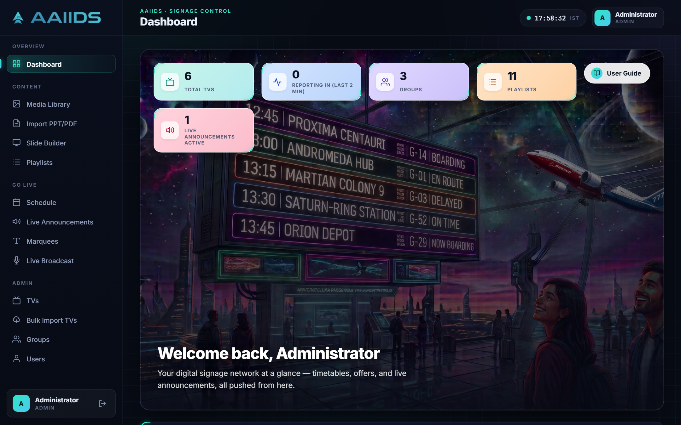
WEB APP
The web app
Everything an operator needs, from uploading a video to taking over every screen, in one dark-mode dashboard.
Dashboard: TV, group and playlist counts at a glance, plus who is online right now.
AAIIDS · sams_tvaai signage
9
Notes:
Section: the web app. The dashboard gives an at-a-glance view of TVs, groups, playlists and live announcements.

Slide 10
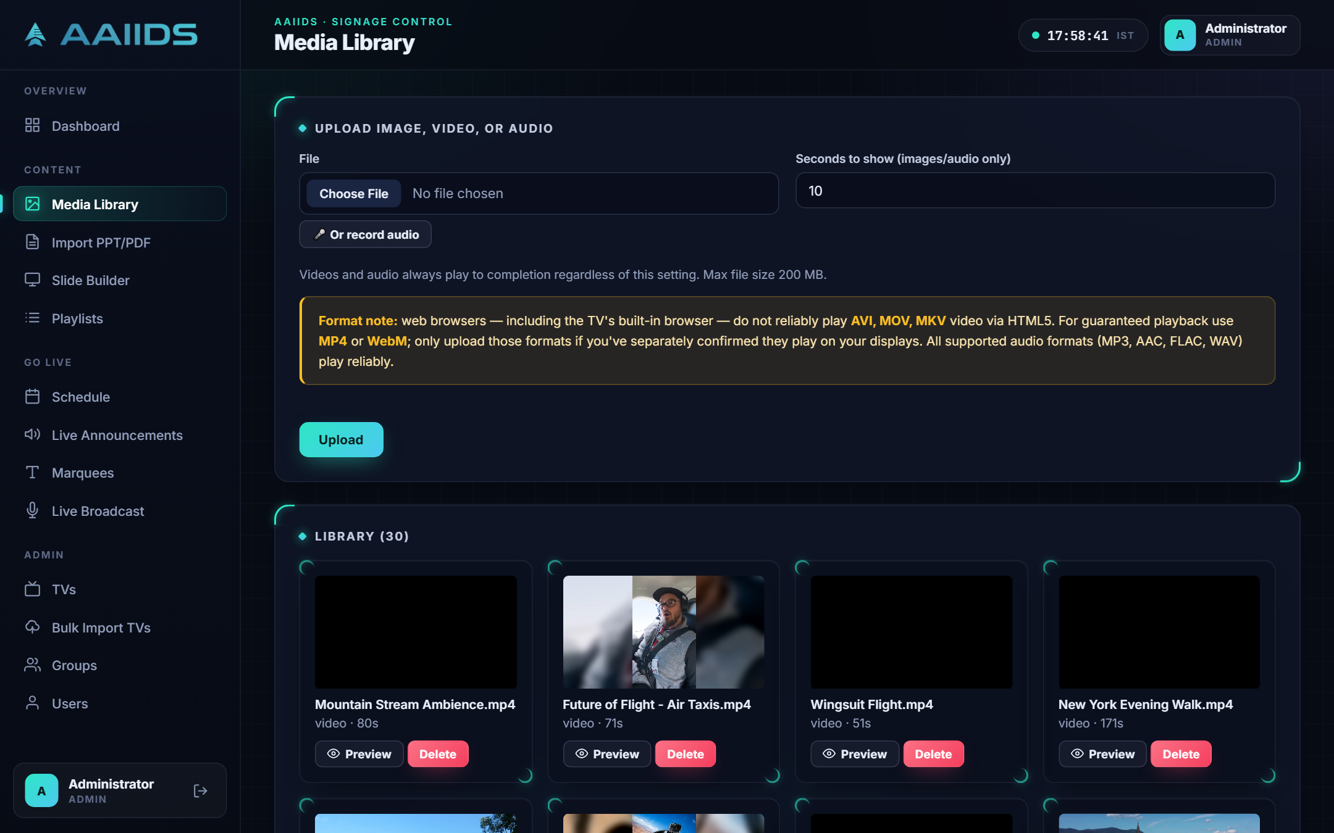
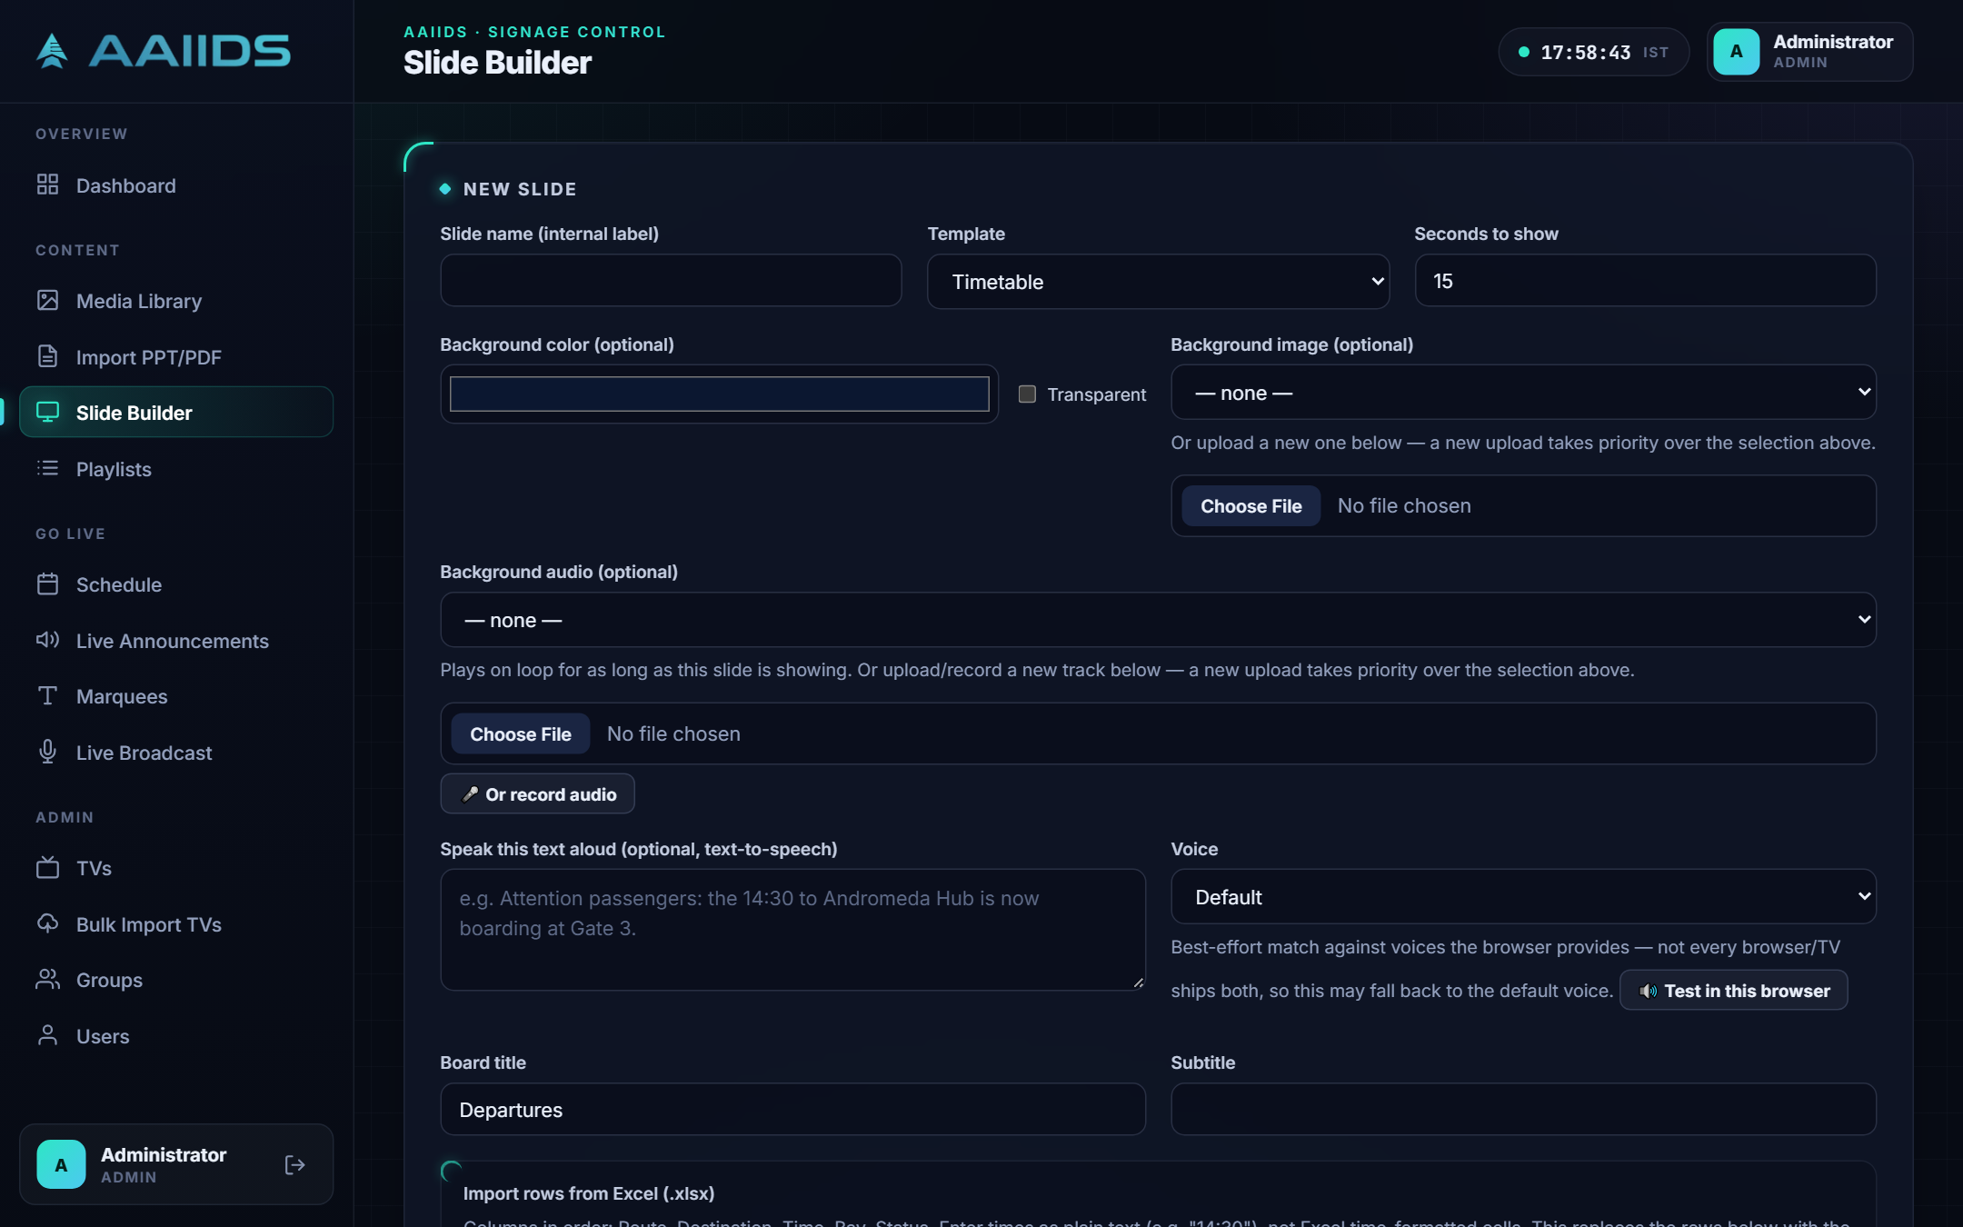
WEB APP · CONTENT
Create content in minutes
Media Library
Slide Builder
Upload photos, videos, audio and PPT/PDF decks, or record audio straight from the mic.
Four templates with background image, video or music, a voice-over and Excel timetable import.
AAIIDS · sams_tvaai signage
10
Notes:
Media Library holds every file. Slide Builder turns a short form into a finished, branded slide.

Slide 11
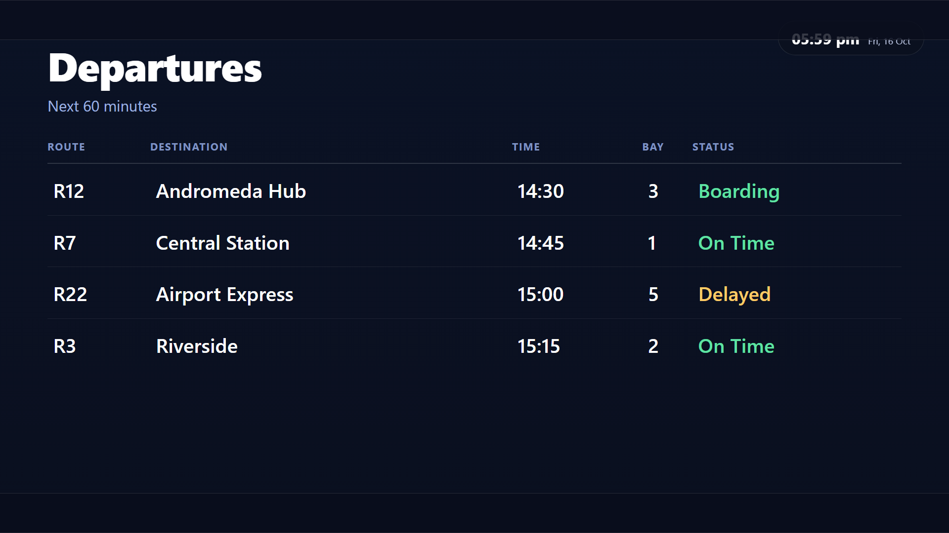

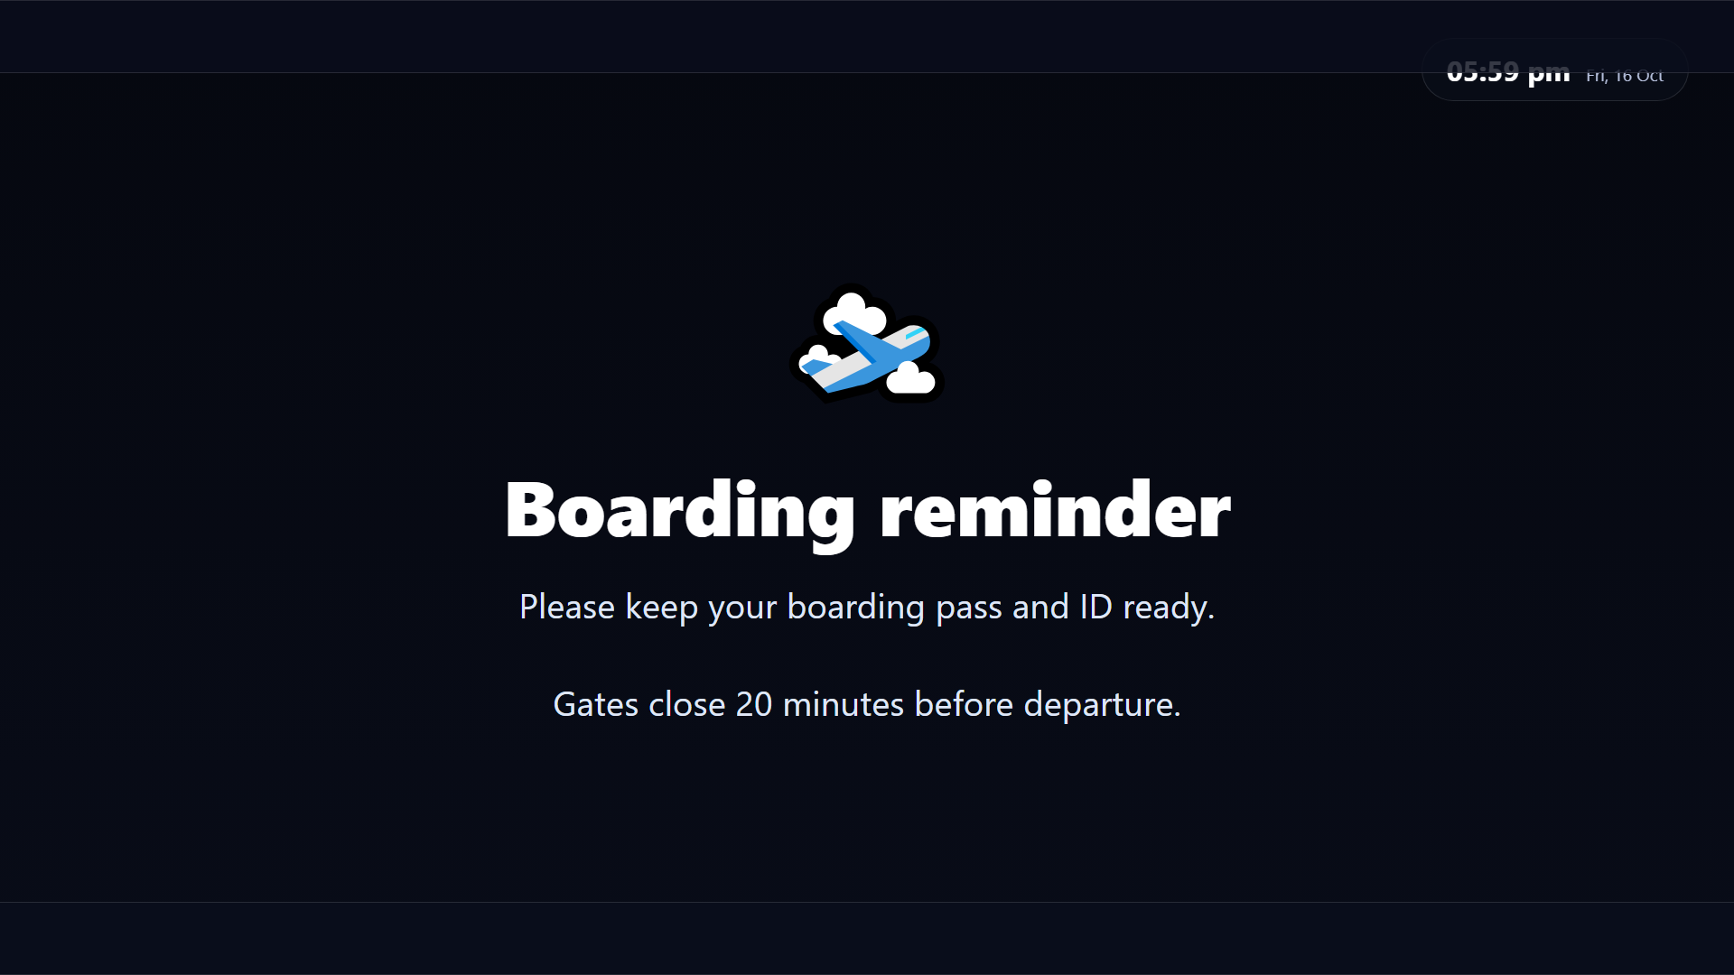
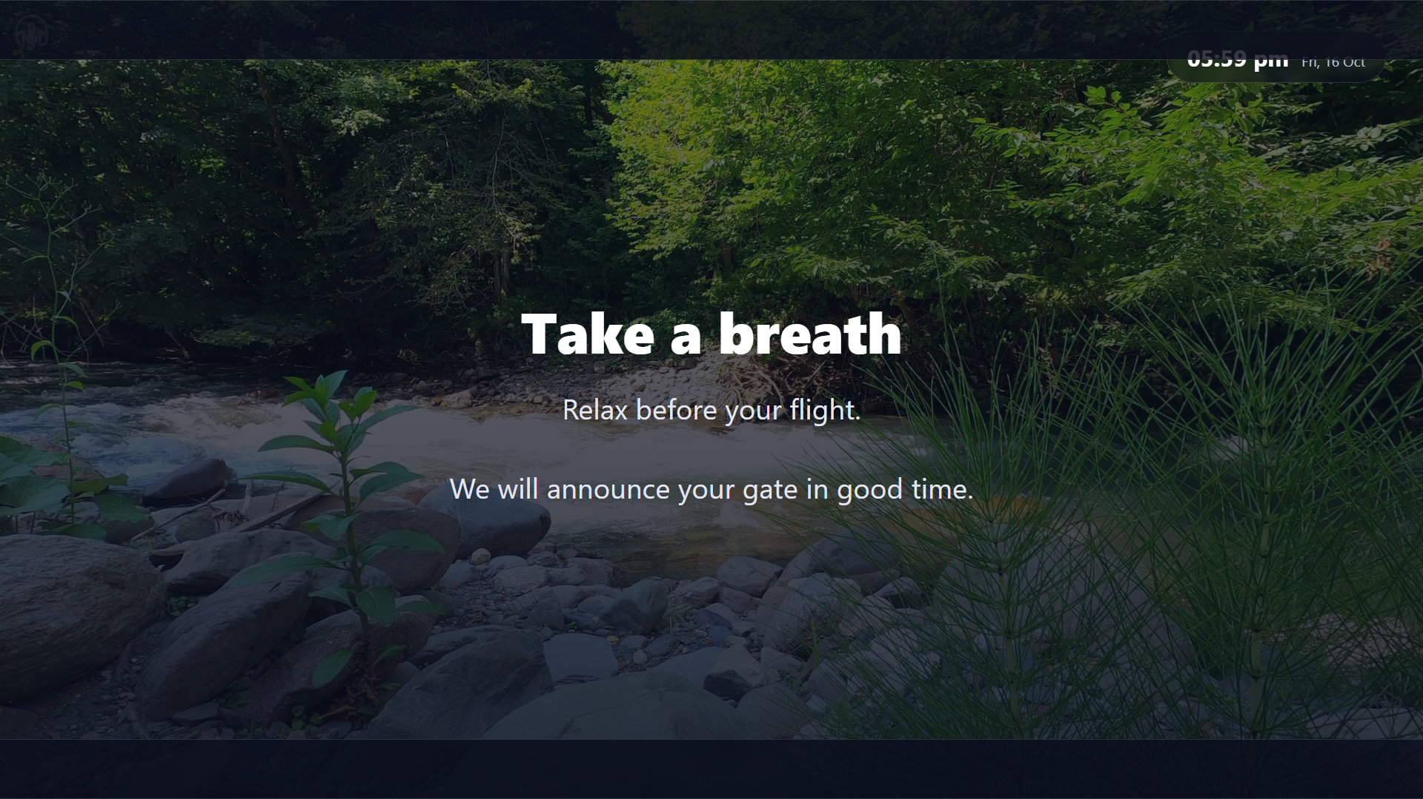
WEB APP · TEMPLATES
Templates that look designed
Fill a form, get a finished slide
Layout, typography and colour come from the template.
Edit a timetable row and every TV showing it updates.
Import timetable rows from an Excel file.
Add a background video, image or music.
Timetable
Offer
Announcement
Custom
AAIIDS · sams_tvaai signage
11
Notes:
These are real renders from the app at 1080p, exactly as the TVs show them.

Slide 12
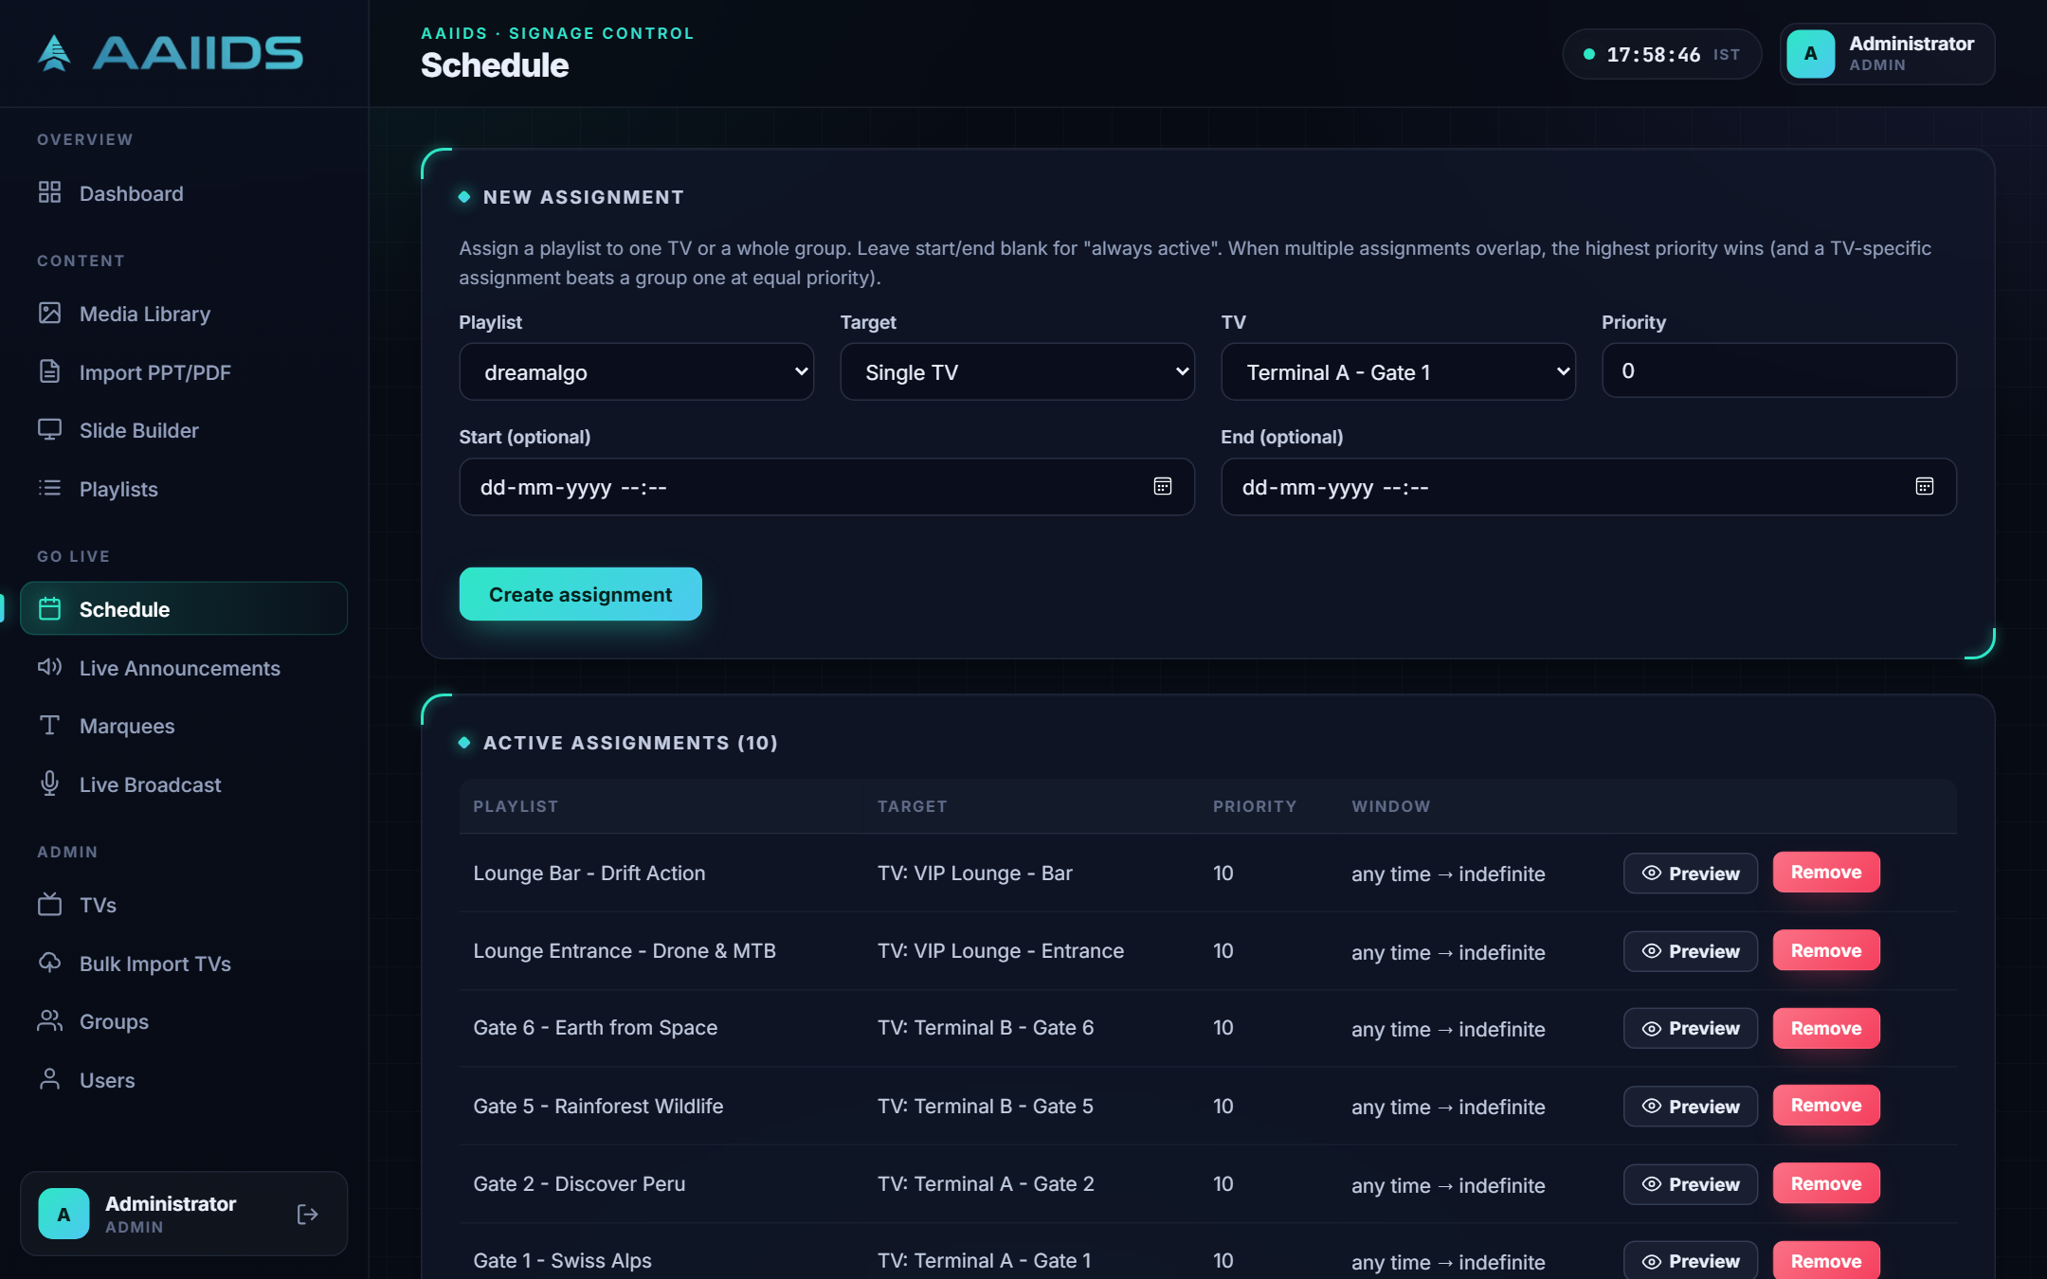


WEB APP · SCHEDULING
Plan what plays, and where
Playlists
Mix videos, photos, slides and decks in any order.
Schedules
Assign to one TV or a whole group, with start and end times.
Priority
When schedules clash, the higher priority wins.
Live view
Preview exactly what any TV is showing now.
AAIIDS · sams_tvaai signage
12
Notes:
Playlists define the loop. Schedules decide which TV or group plays which playlist, and when.

Slide 13
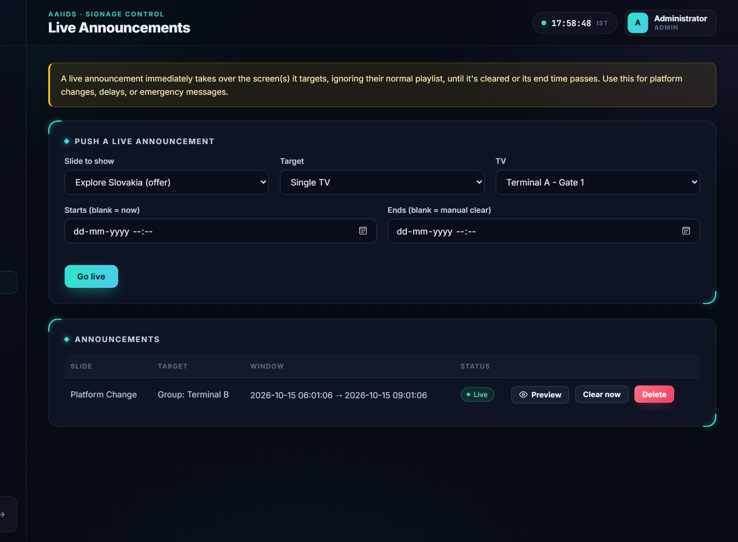
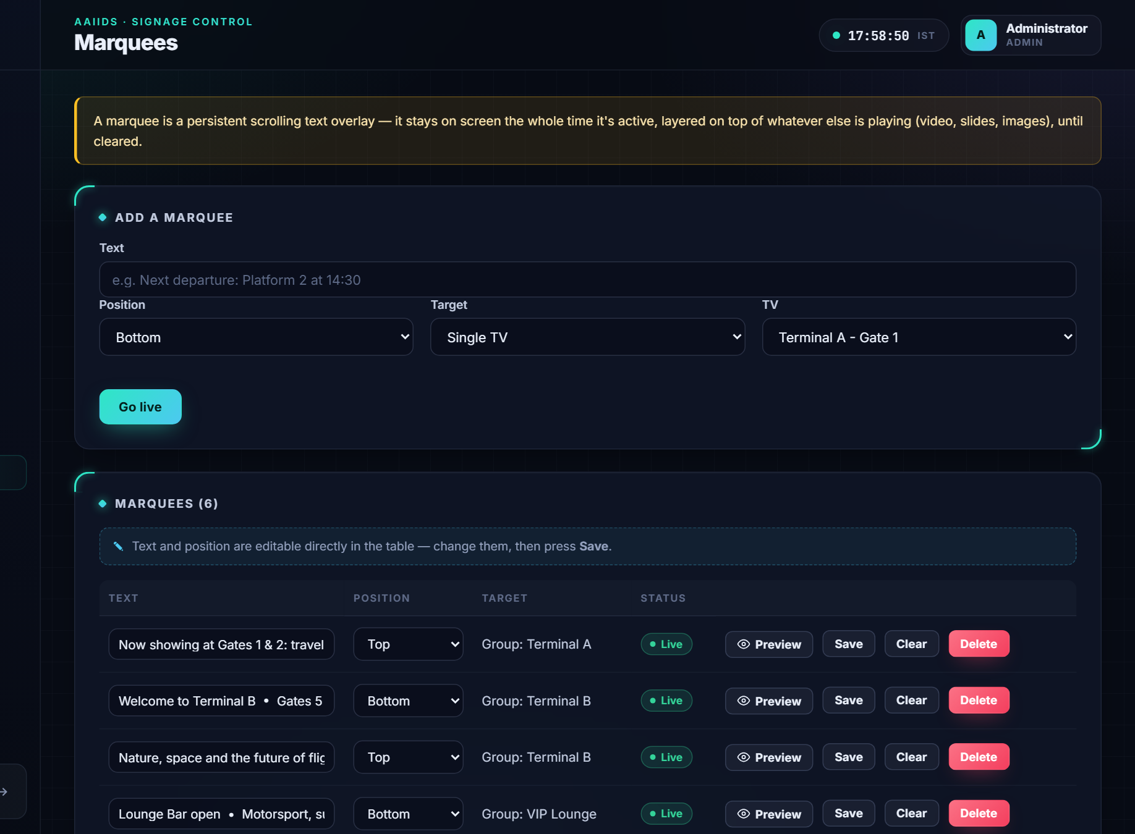
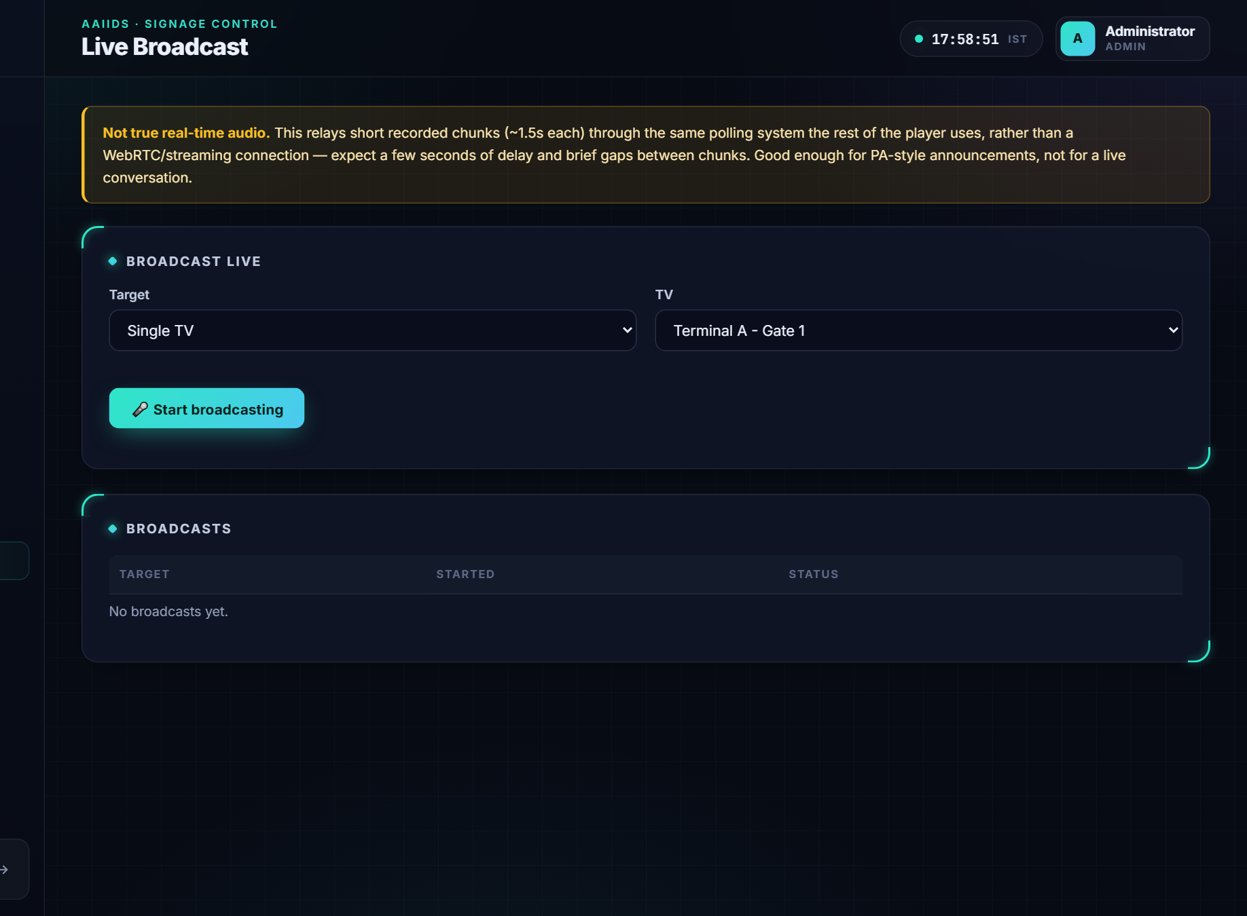



WEB APP · LIVE CONTROL
Take over the screens, live
Live Announcements
Marquees
Live Broadcast
Interrupt any TV or group with an urgent slide for a set time.
Scrolling ticker at the top or bottom, on top of anything playing.
Speak from the browser and the TVs play your voice a few seconds later.
AAIIDS · sams_tvaai signage
13
Notes:
Three ways to reach passengers right now, without touching the playlists.

Slide 14
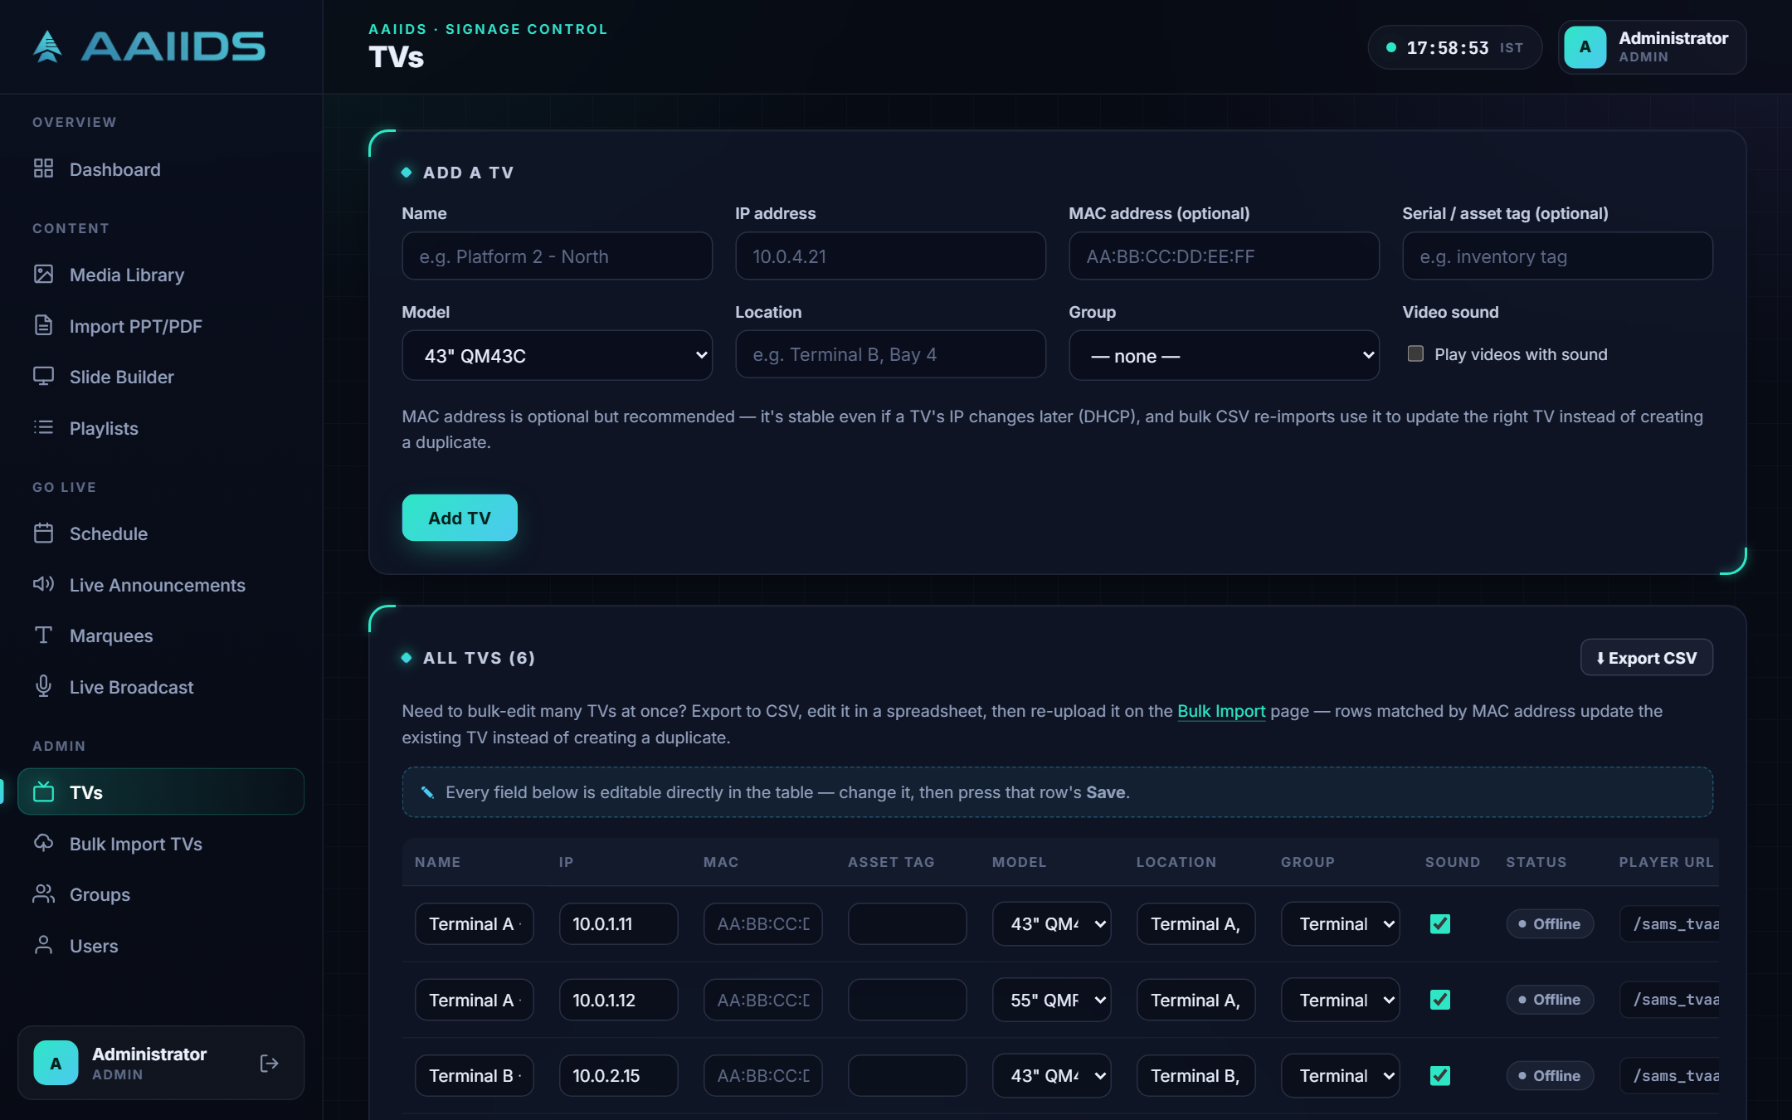




WEB APP · DEVICES
Manage every TV in one table
Edit inline
Name, IP, MAC, location and group, then Save.
Bulk CSV import
Matched by MAC address, so IP changes don't duplicate.
Groups
Target a whole terminal or lounge at once.
Private player link
One token per TV, regenerated in one click.
AAIIDS · sams_tvaai signage
14
Notes:
Every field is editable inline. Bulk CSV import and export keep large estates tidy.

Slide 15
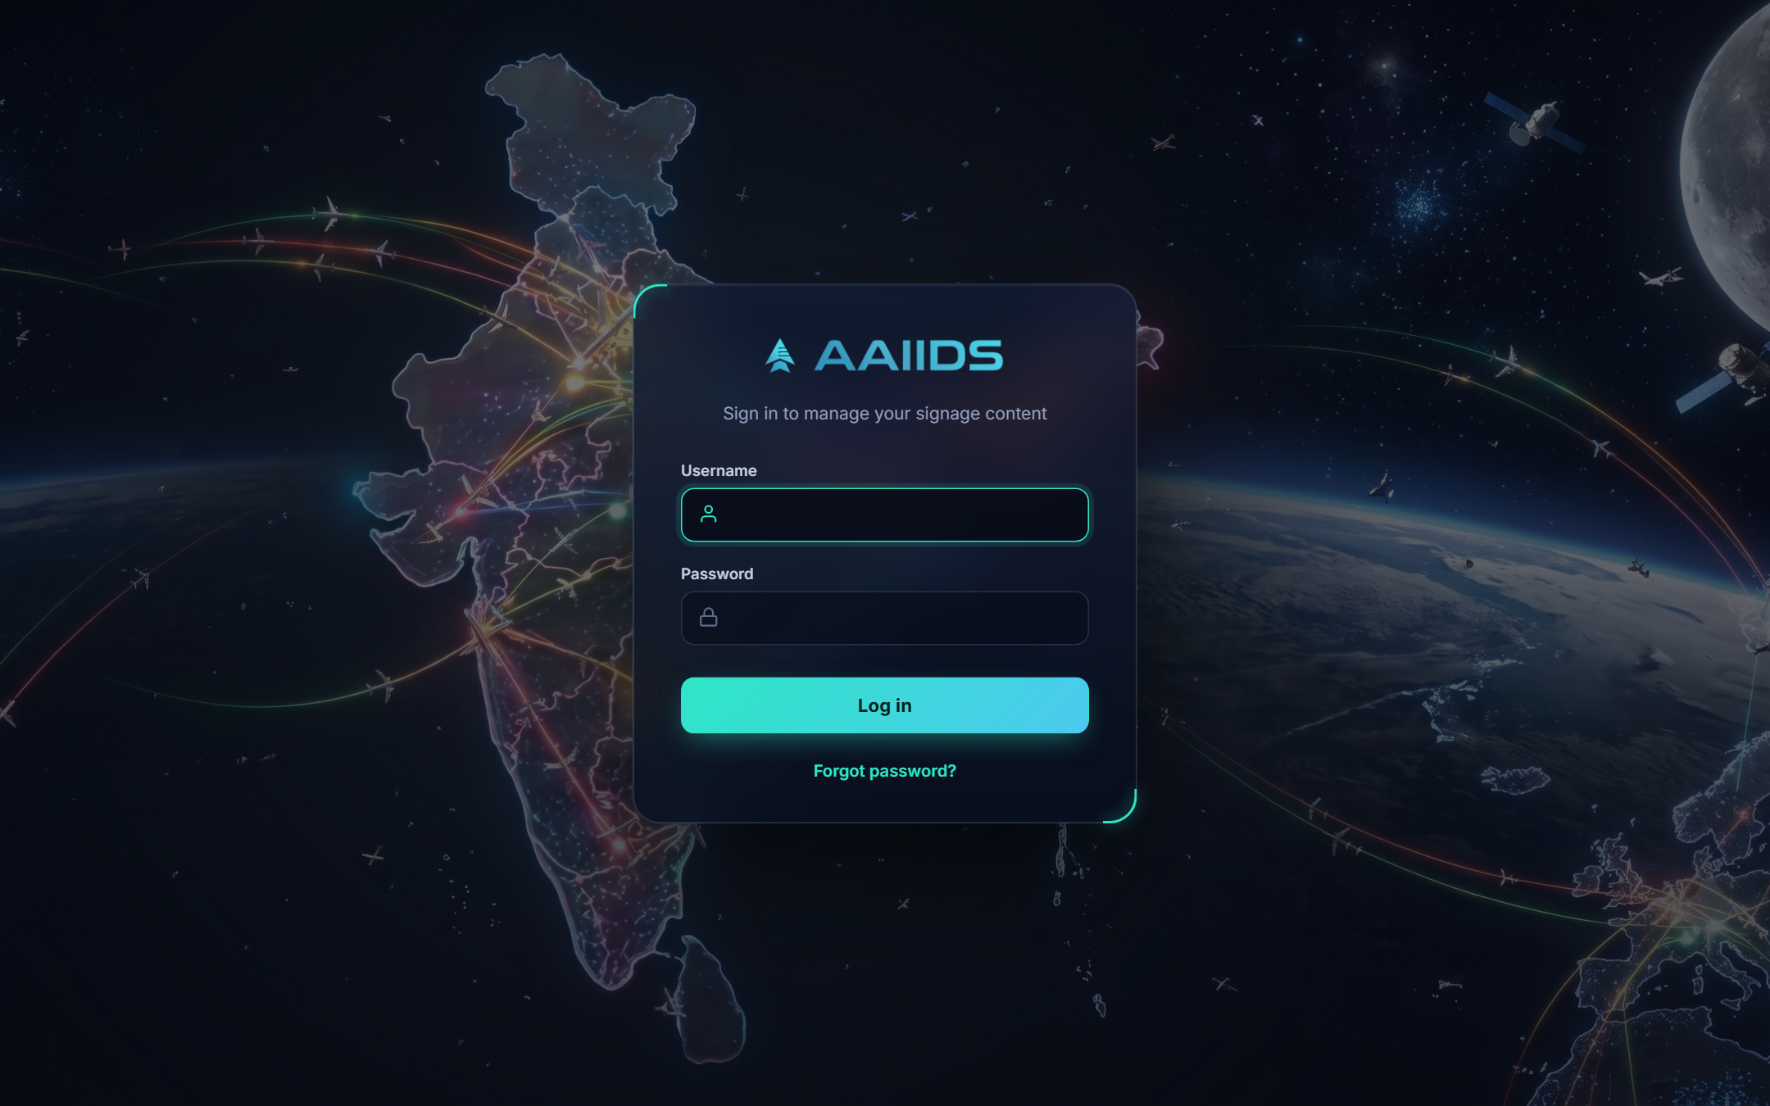



WEB APP · SECURITY
Secure by design
Two roles
Admins manage TVs and users; editors manage content.
Lockout
Sign-in locks after 5 failed attempts.
CSRF protection
Every form action carries a per-session token.
Safe password reset
One-time links; only hashed tokens are stored.
Sign-in page with lockout protection and self-service password reset.
Daily sign-out
All sessions end at 6 AM every day.
AAIIDS · sams_tvaai signage
15
Notes:
Security features built into the core, not bolted on.

Slide 16
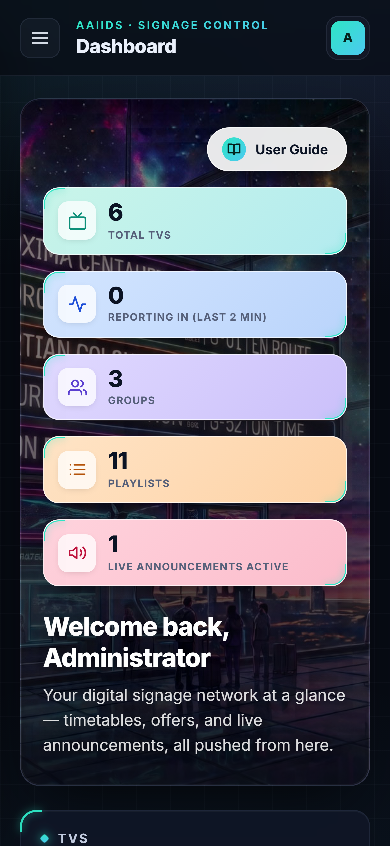
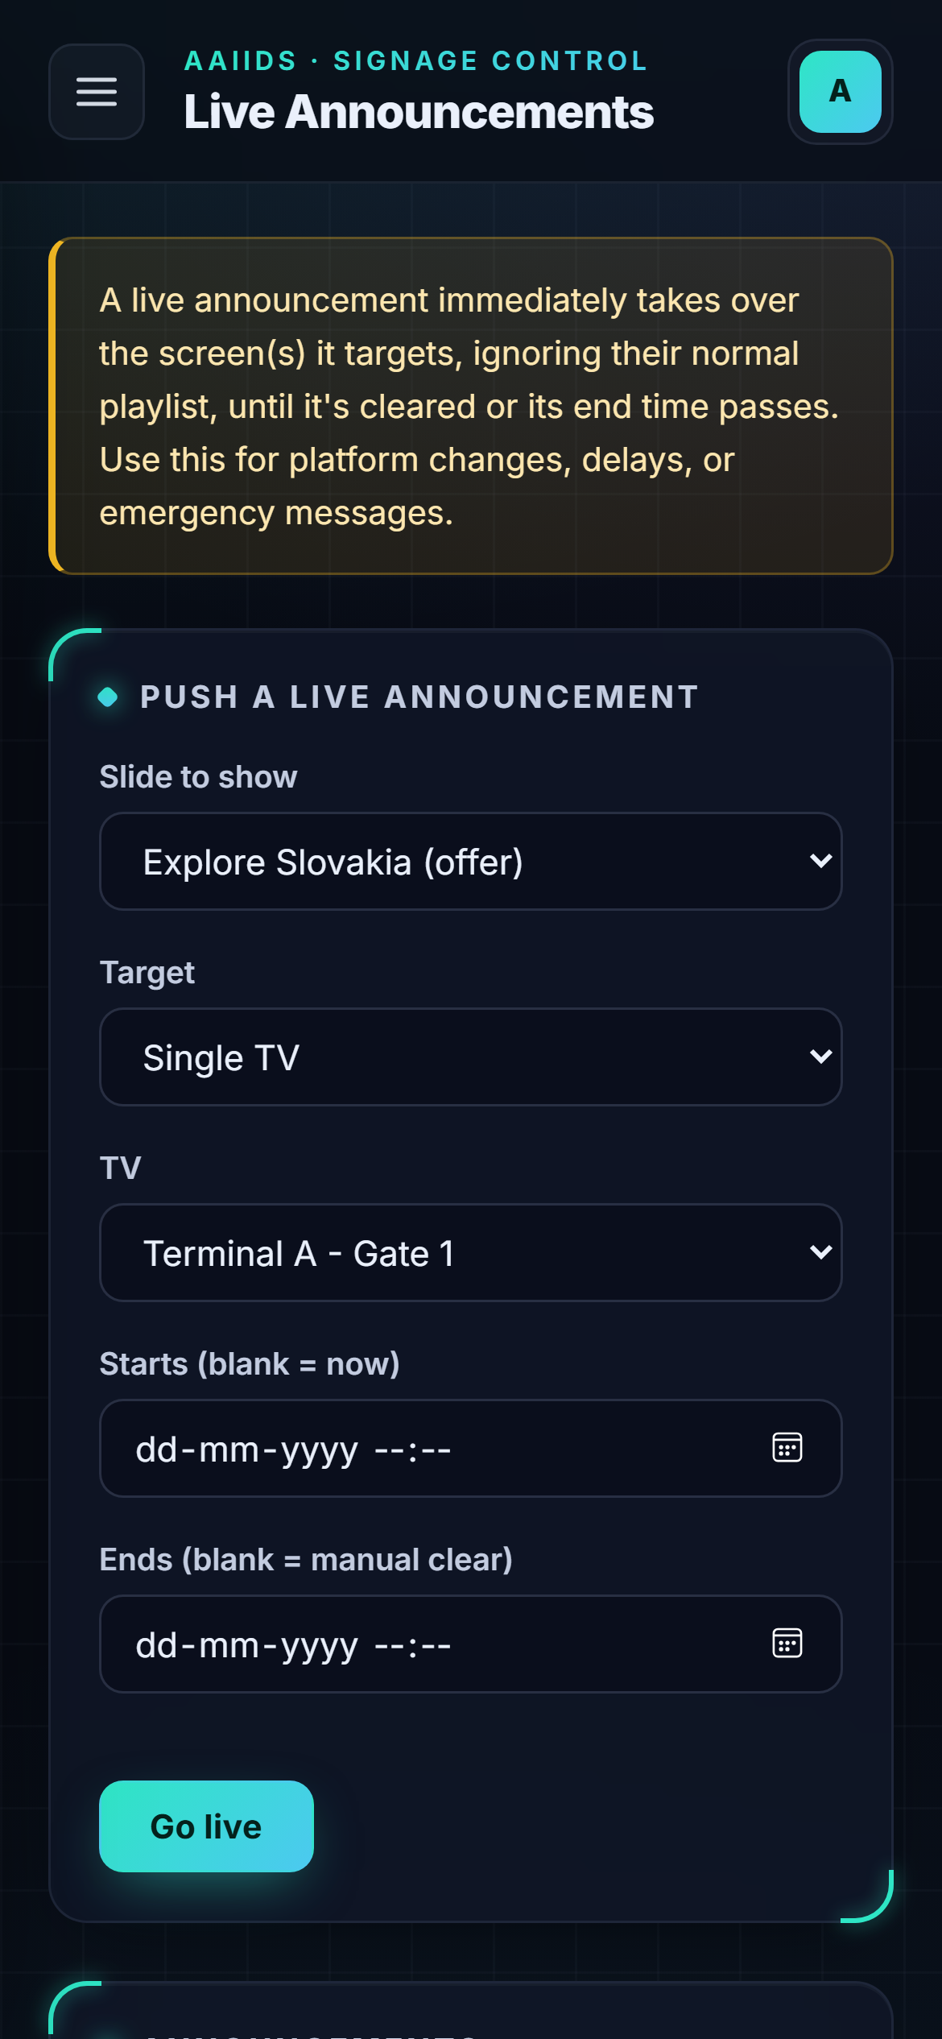
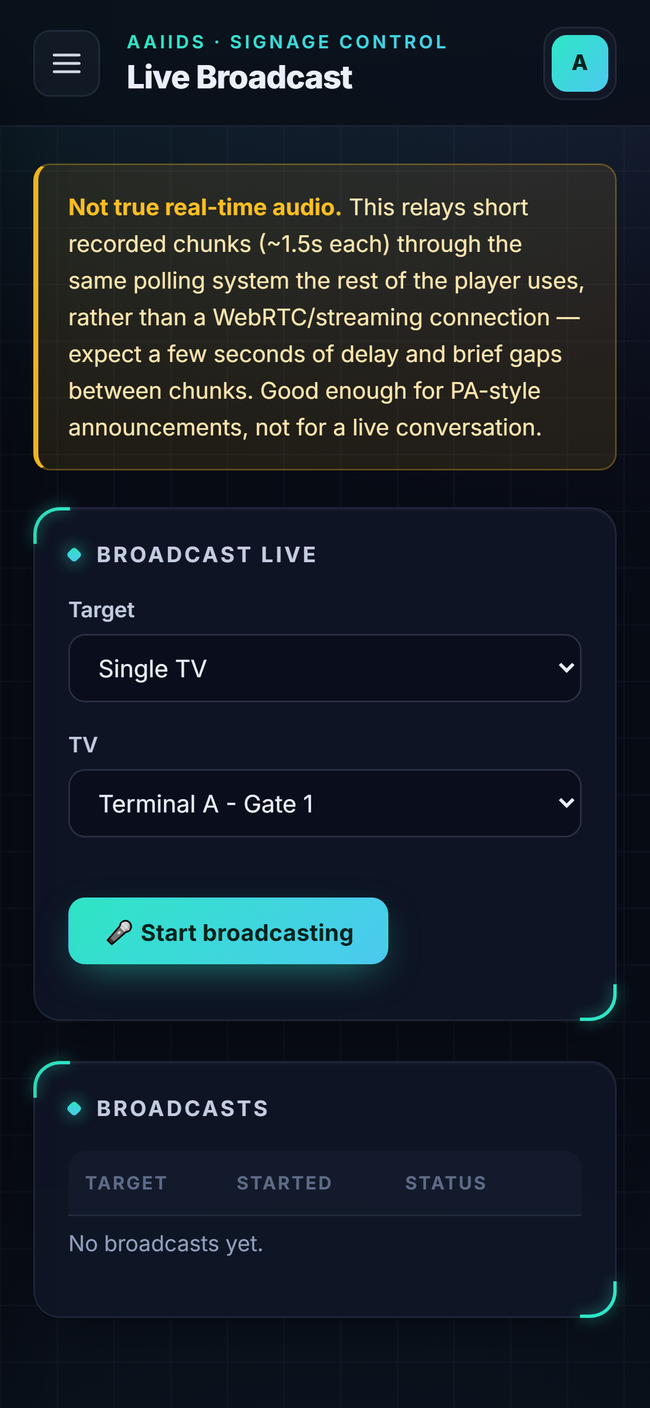

MOBILE
The control room in your pocket
The whole admin adapts to a phone screen. Open the same link, sign in, and you're in control.
Push an announcement
From the platform, in seconds.
See what's online
Live TV status on the dashboard.
Go live by voice
Broadcast with the phone's mic.
AAIIDS · sams_tvaai signage
16
Notes:
There is no app store install. The same web app adapts to a phone screen, so staff can act from the platform floor.

Slide 17
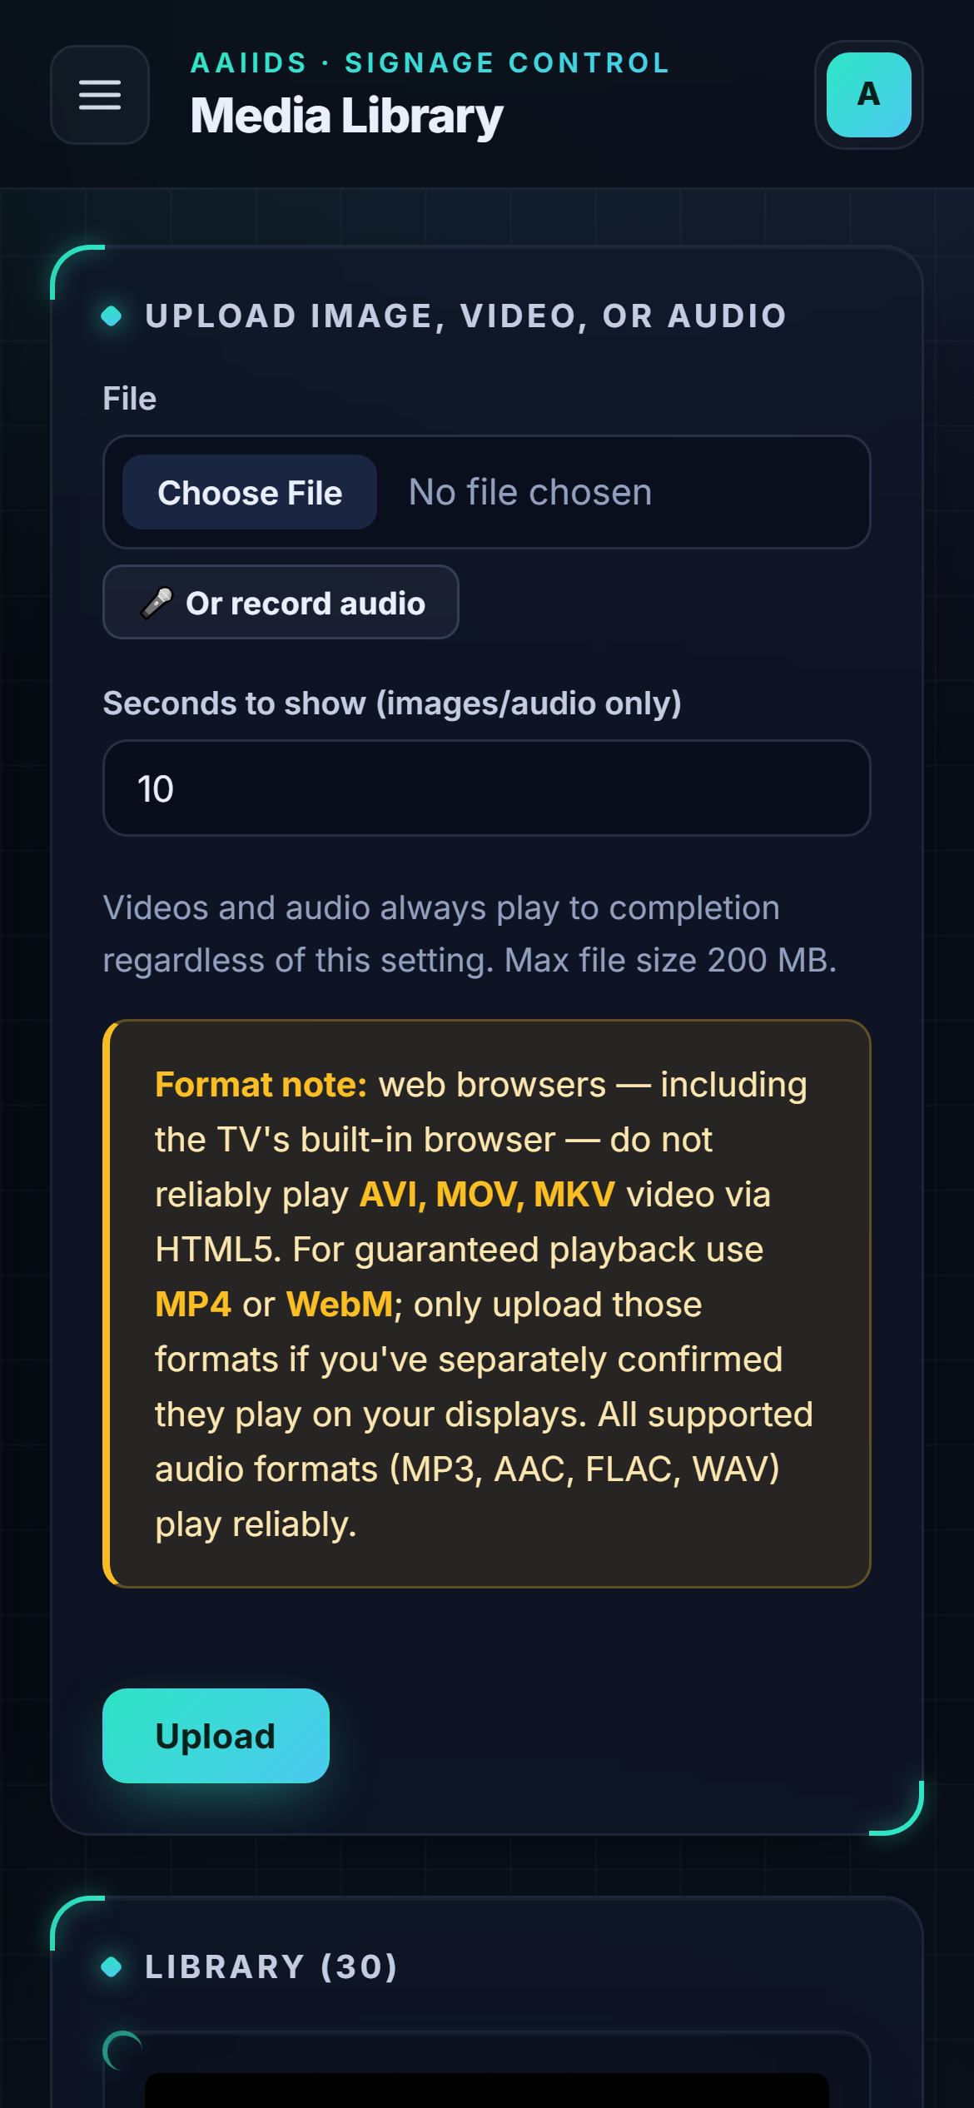
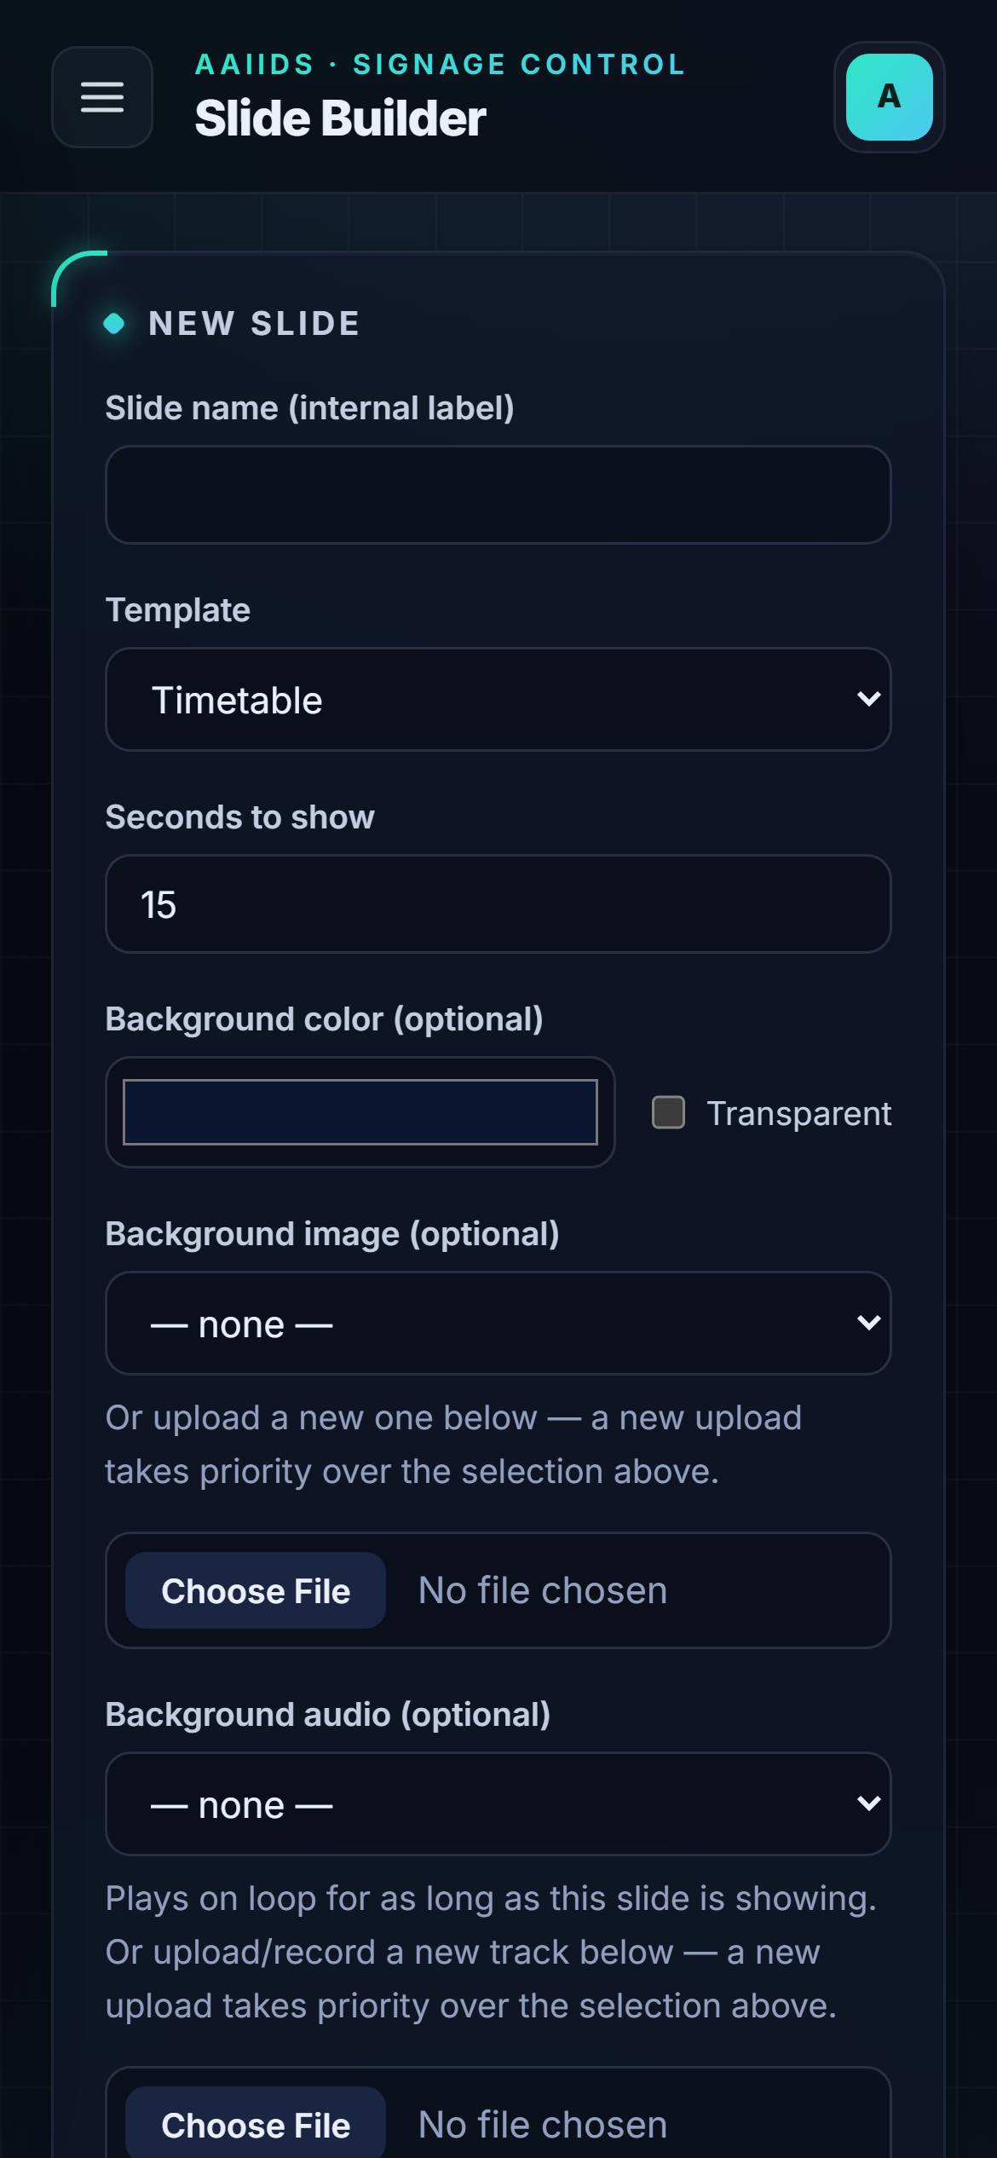
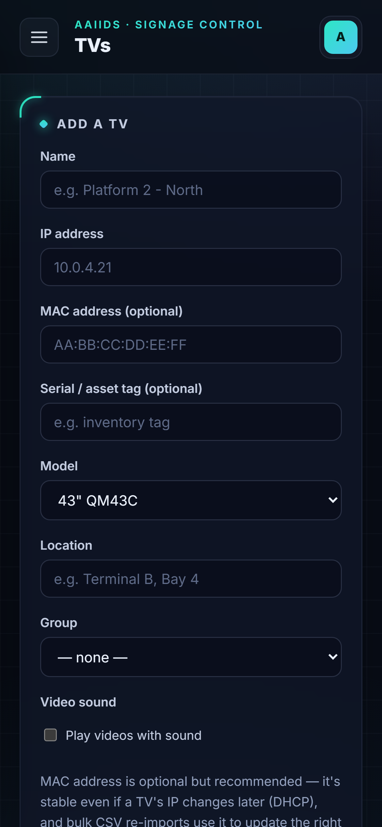

MOBILE
Create and manage on the go
Built mobile-first
Upload photos and videos straight from the phone's camera or gallery.
Record audio for a slide with the phone's microphone.
Tables scroll sideways; menus fold into a slide-out panel.
Works in Chrome on Android and Safari on iPhone.
Upload from camera
Build a slide
Add or edit a TV
AAIIDS · sams_tvaai signage
17
Notes:
Content creation and TV management work just as well on a phone.

Slide 18
ON THE TV
What passengers see
Terminal A · Gate 1
VIP Lounge · Bar
Swiss Alps film with sound, travel marquee on top, safety notice below
Drift racing film with sound, Wi-Fi and lounge tickers
AAIIDS · sams_tvaai signage
18
Notes:
Real captures from the player: a different film on each TV with sound, plus marquees on top.

Slide 19
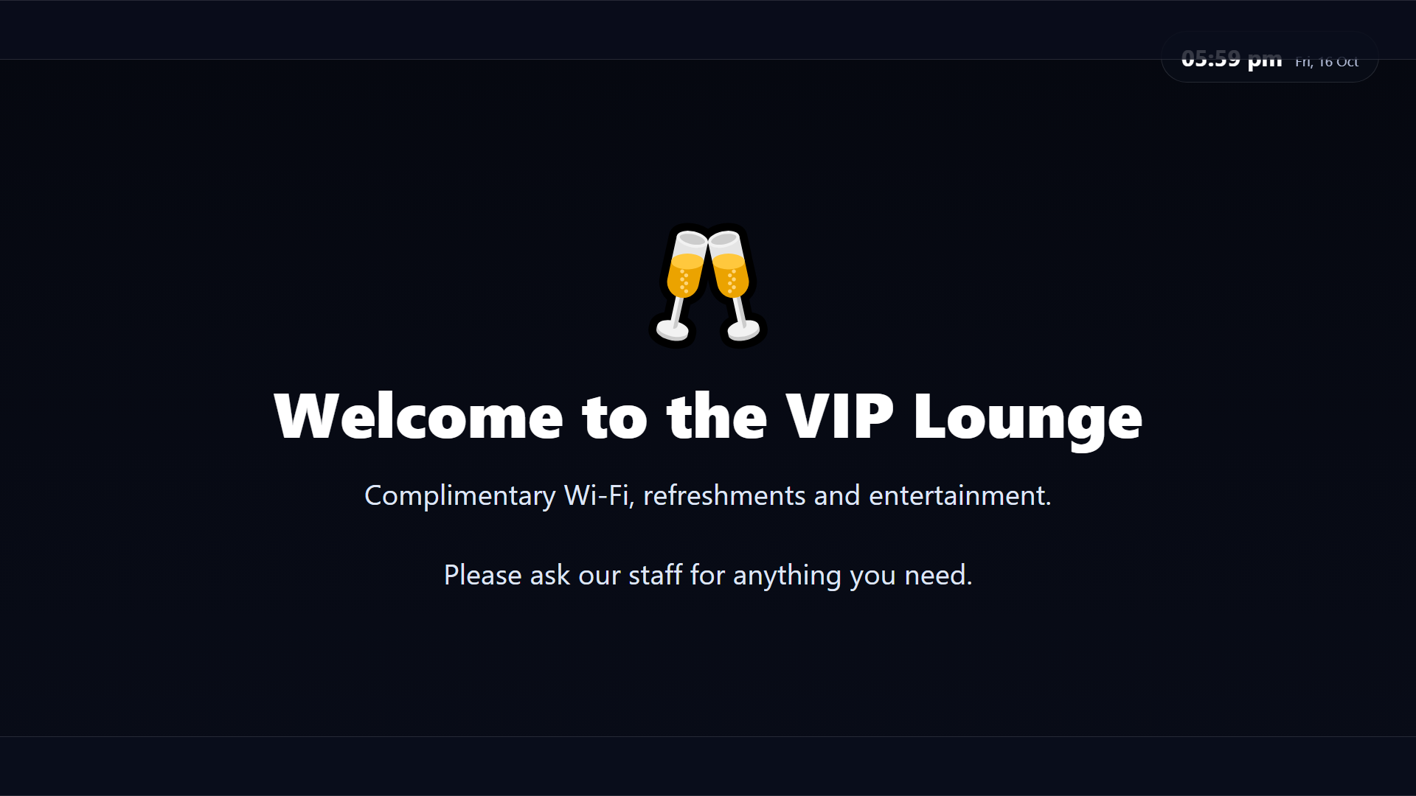

GETTING STARTED
From install to
on-screen, fast
1
Install Copy the app to XAMPP or cPanel and import the database.
2
Secure Change the default admin password and add SMTP for resets.
3
Connect Paste each TV's player link into its URL Launcher.
4
Create Upload content, build slides and schedule playlists.
AAIIDS · sams_tvaai signage
19
Notes:
Wrap up with the four steps to get a new site running.

